Slide 1

Maintaining Conservation
While Aiding in
Compact Compliance

Slide 2
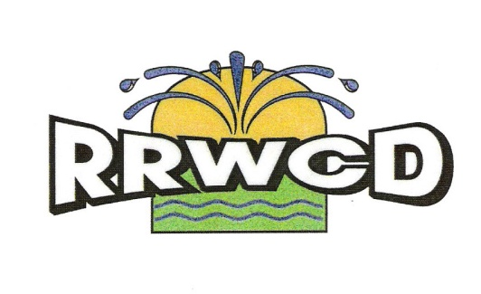
Republican River Water Conservation District
Deb Daniel, General Manager
deb.daniel@rrwcd.com
970-332-3552

Slide 3
What is the
RRWCD?...
and where is the
RRWCD
located?

Slide 4
It’s all about
location… location… location…

Slide 5
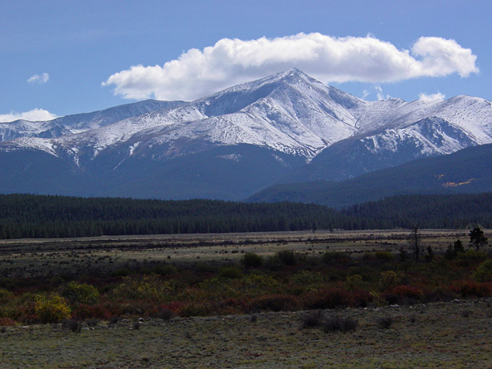
… a beautiful view… but definitely not in the Republican River Basin

Slide 6
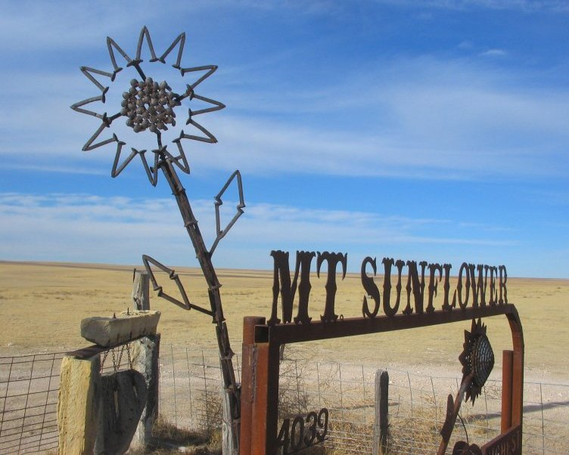
The only mountain in the Republican River Basin is Mt. Sunflower in Kansas

Slide 7
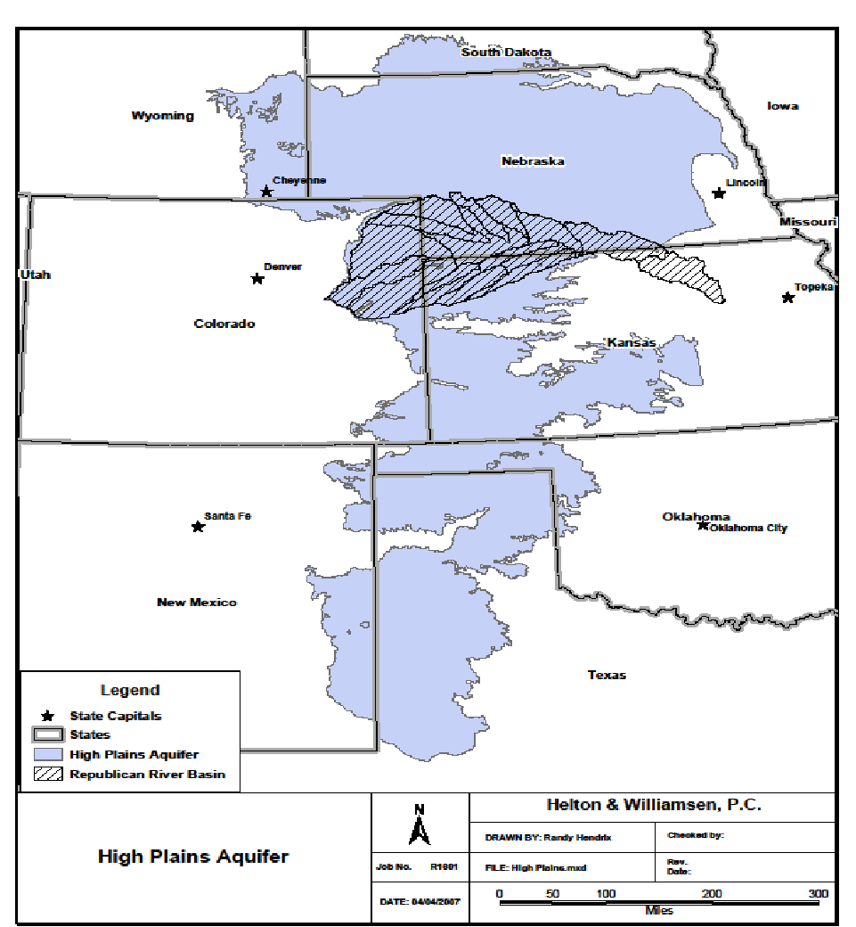

Slide 8
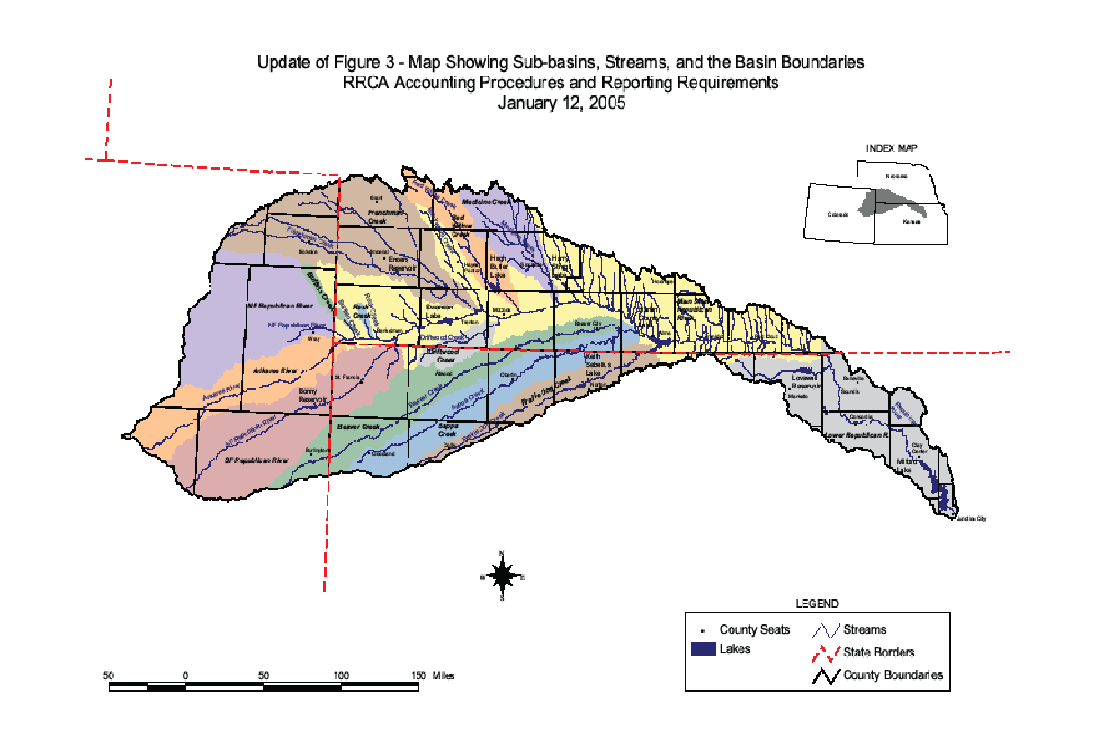
Notes:
Most aware of the Republican River Compact…1942

Slide 9
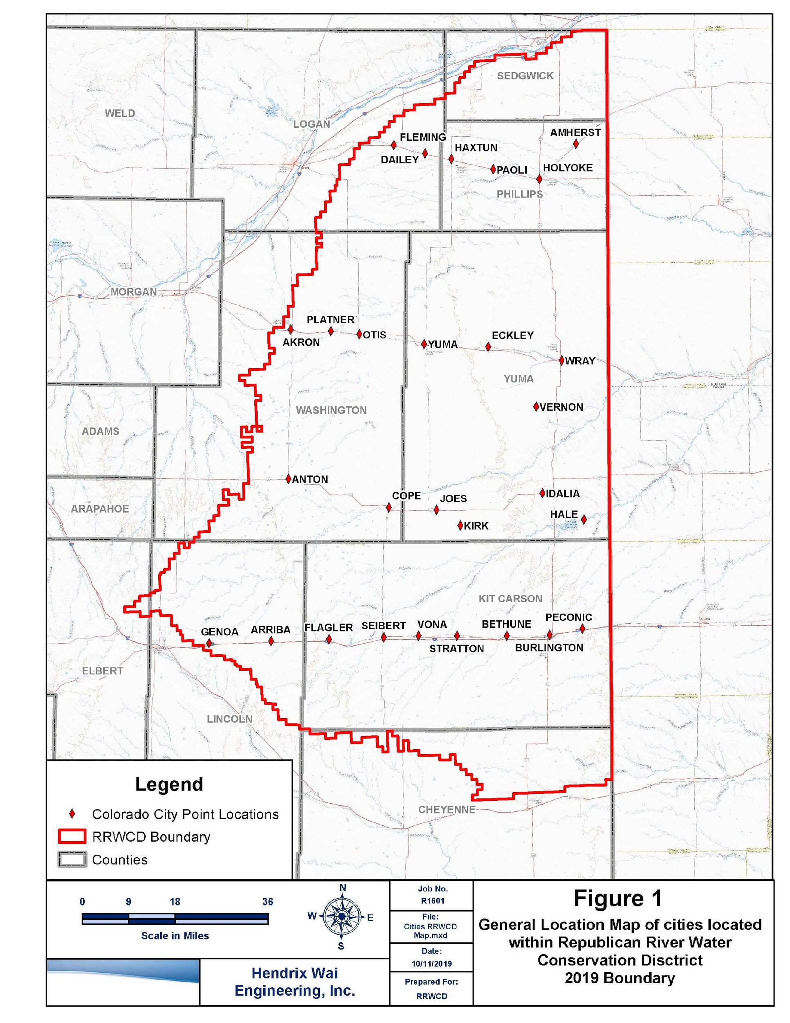
A map showing the 8 counties and 8 groundwater management districts
in the Republican River Basin in Colorado.

Slide 10
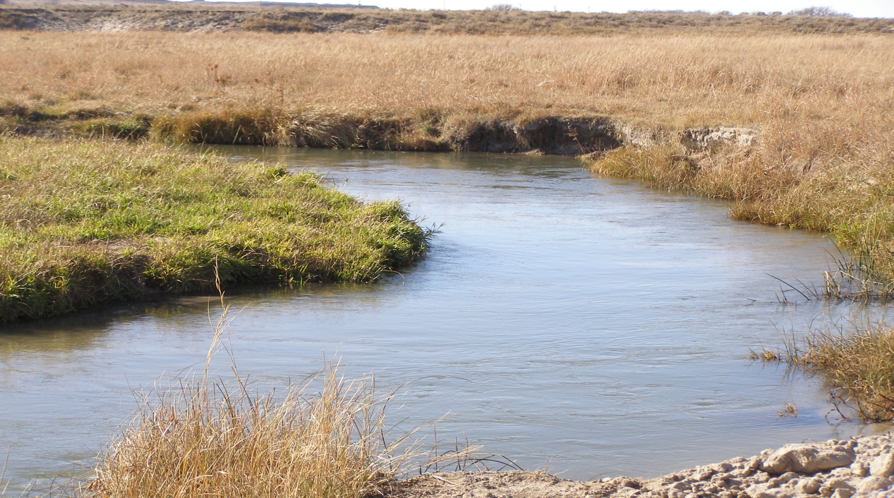
The North Fork of the Republican River

Slide 11
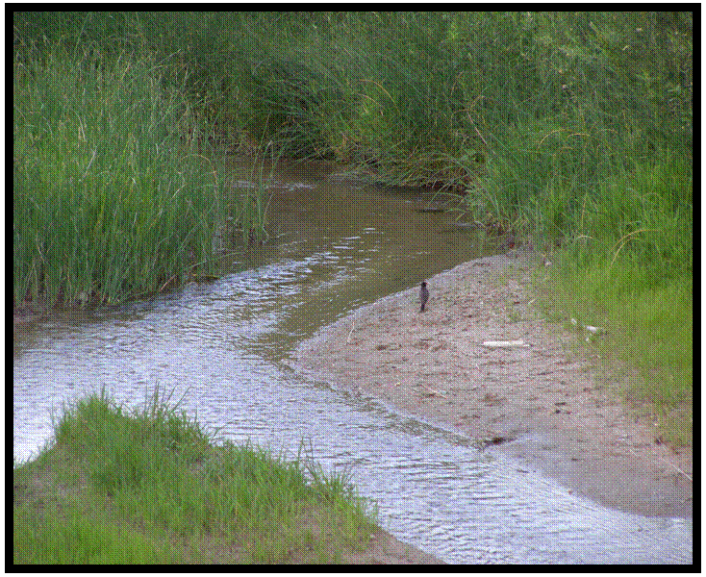
The South Fork of the Republican River

Slide 12
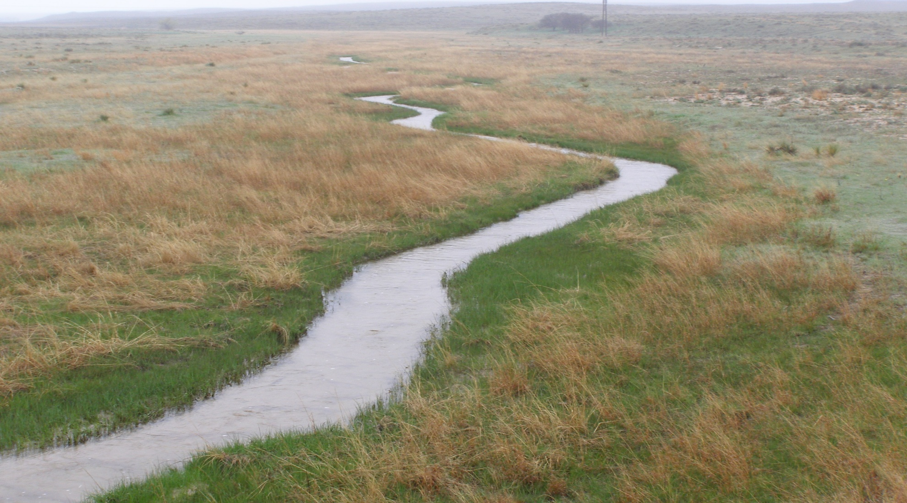
The Arikaree River

Slide 13
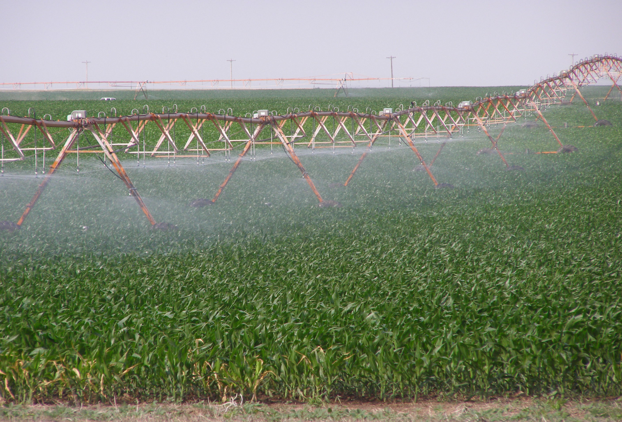
Irrigated corn is the primary crop grown in the Republican River Basin

Slide 14
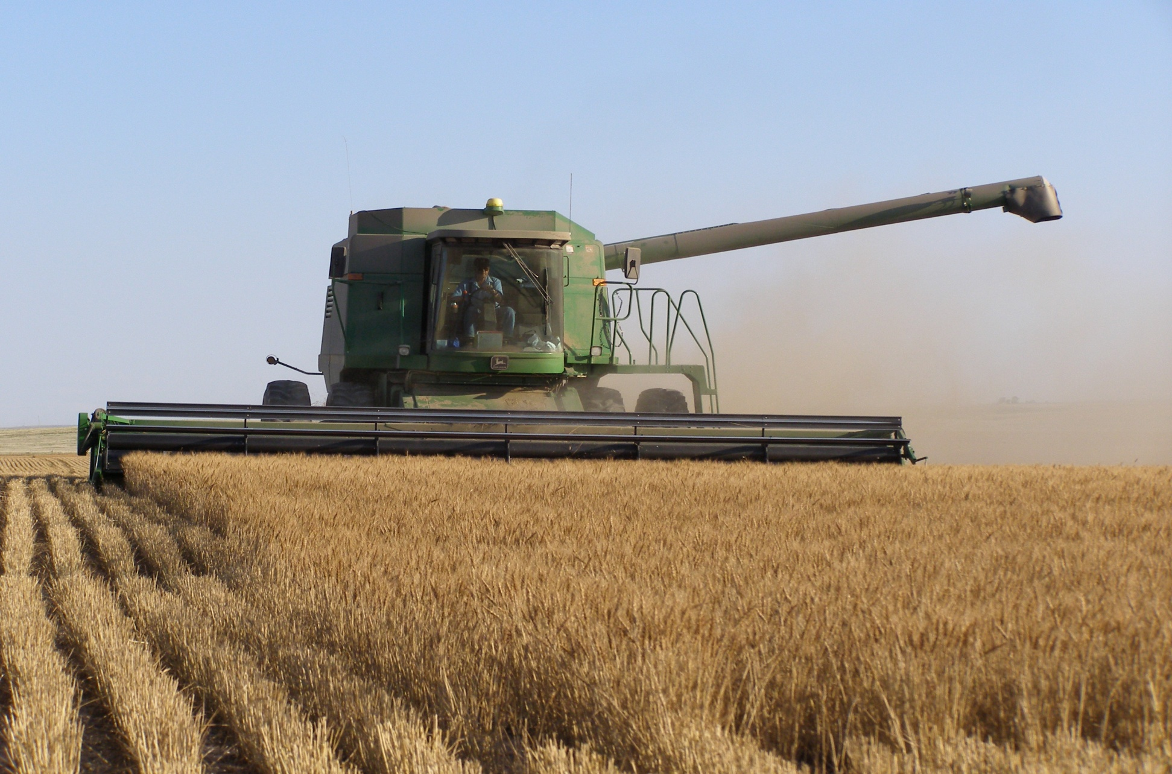

Slide 15
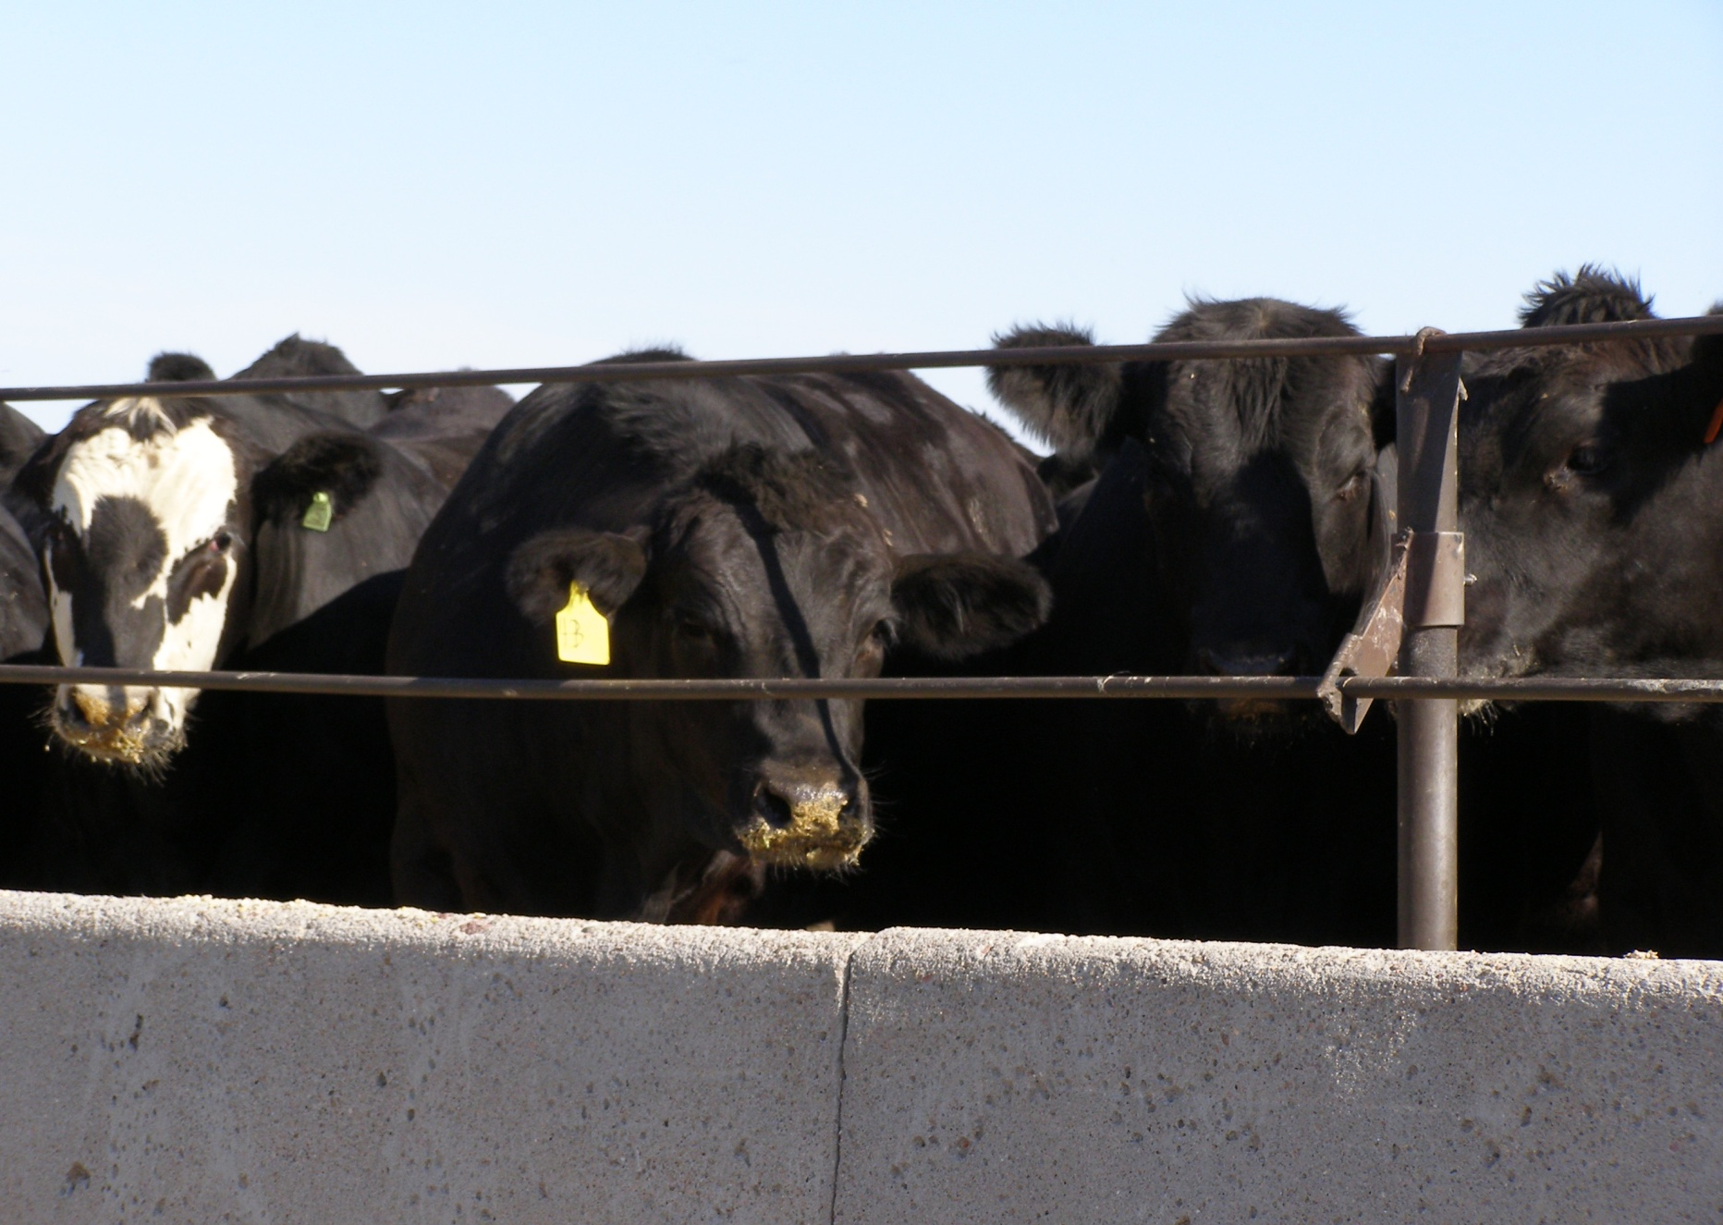

Slide 16
In the beginning…
The Dirty Thirties

Slide 17
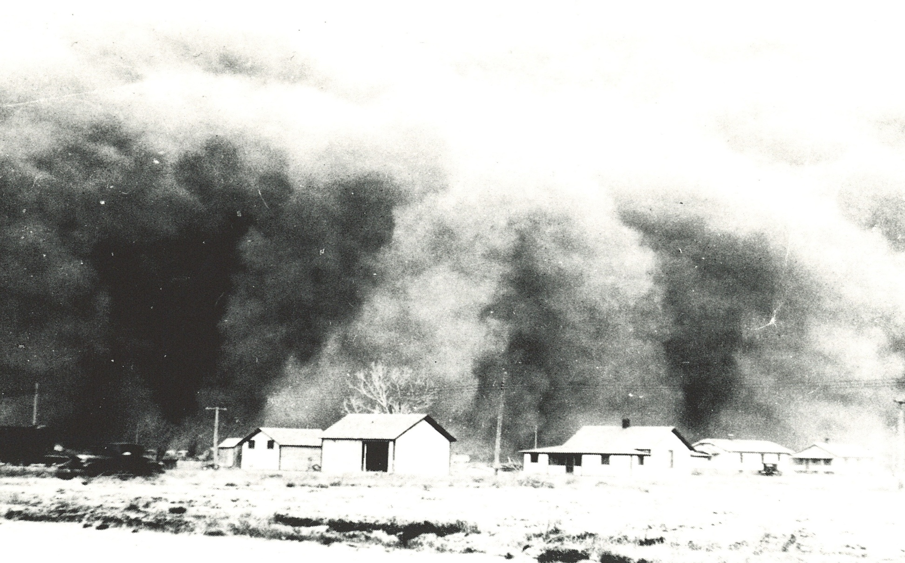
A dust storm in Nebraska during the Dirty Thirties

Slide 18
The Flood of 1935
On May 30th, 1935 a huge thunderstorm built on the plains of Colorado and started a down-pour in the western end of the Republican River Basin. By 3:00 AM on May 31st the river had grown to flood stage near Cope, Colorado. The storm continued moving east through the Basin with the river rising up to “bluff to bluff” levels. Some areas in the Basin received up to 14 inches of rainfall. In rural communities the river grew to over a mile wide and measured up to 17 feet deep.
The water was moving 5 – 10 miles an hour. The flood waters reached the east end of the Basin at Clay Center, Kansas, on June 3rd, 1935. The devastation that was left behind was almost more than what the people could bear after suffering from several years of severe drought.

Slide 19
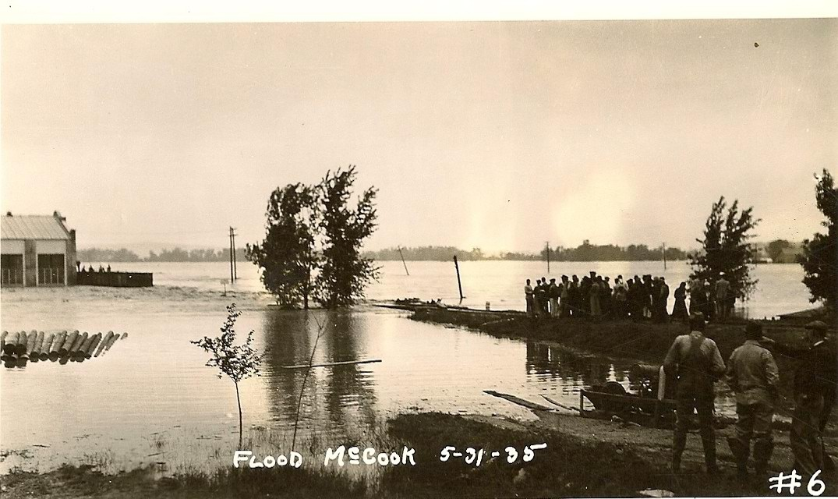
Flood waters continuing to rise near McCook, NE

Slide 20
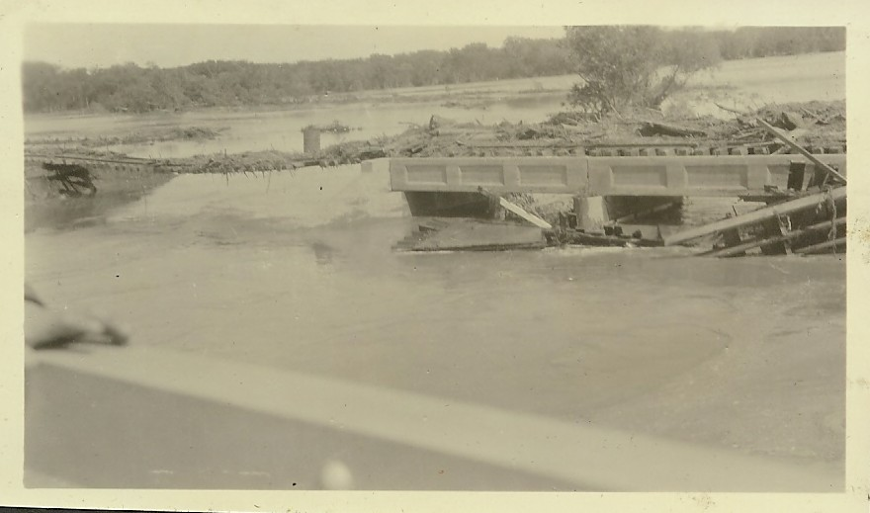
Damage caused by flood to railroad bridge

Slide 21
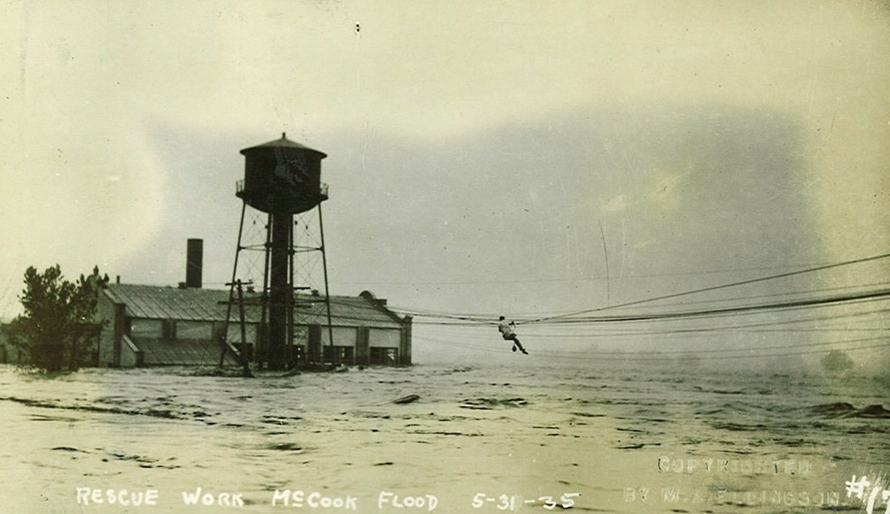
Two men are rescued from the Nebraska Light and Power Company before supporting power poles are washed away and building collapses.

Slide 22
Damage from
Flood of 1935
in
Colorado, Nebraska & Kansas
Lives lost (many bodies were never found) 110 residents drown
Livestock killed 20,593 cattle & pigs
Poultry killed 46,500
Highways damaged 830 miles
Crops damaged 263,615 acres
Railroads damaged 171 miles
Railroad bridges damaged 83 bridges
This information was taken from the U.S. Geological Survey Water Supply Paper 796-B

Slide 23
In an effort to primarily provide flood control
The Republican River Compact
Is written and signed by
Colorado, Nebraska and Kansas
on December 31, 1942

Slide 24
The major purposes of the compact are to provide for the most efficient use of the waters of the Republican River Basin for multiple purposes;
to provide for an equitable division of such waters;
to remove all causes, present and future, which might lead to controversies;
to promote interstate comity;
to recognize that the most efficient utilization of the waters within the Basin is for beneficial consumptive use;
to promote joint action by the states and the United States in the efficient use of water and the control of destructive floods.

Slide 25
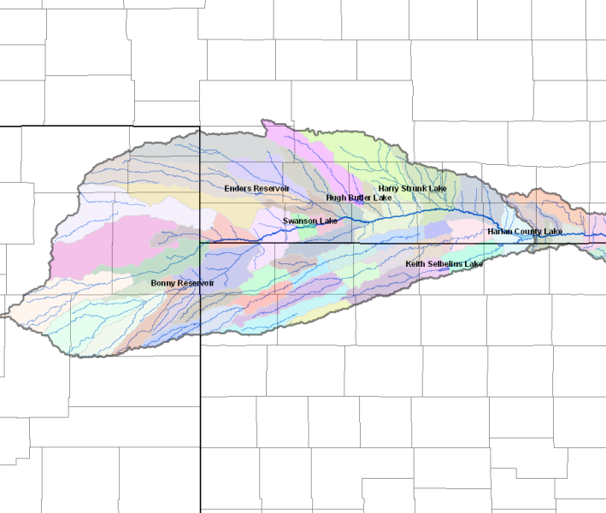
Nebraska
Kansas
Colorado
Seven reservoirs were built by the Army Corp of Engineers as a result of the Republican River Compact.

Slide 26
Colorado Efforts To Get
Into Compliance
With The
Republican River Compact
Notes:
What I am going to talk about today

Slide 27

In 2004 the
Colorado State Legislature
created the
Republican River Water Conservation District
to assist the State to carry out its duty to comply with the limitations and duties imposed upon the State by the Republican River Compact.
Notes:
Purpose of the District – Assist the State

Slide 28
The Republican River Water Conservation District is an independent entity that is entirely self-governed.
The Seventeen members of the Board of Directors are residents of the basin appointed by the:
Colorado Ground Water Commission
County Commissioners of eight counties within the Basin
Board members of eight groundwater management districts within the Basin

Slide 29

What actions can the Republican River Water Conservation District do to assist the State of Colorado reach compliance with the federal law imposed by the Republican River Compact?

Slide 30
Funding Source Water Use Fees ~~ collected from each county
Irrigation $14.50/acre
Municipal/Commercial $5.80/acre-foot
Consumptive Use $257.00/acre-foot
Surface Water Use $154.00/ acre-foot

Slide 31
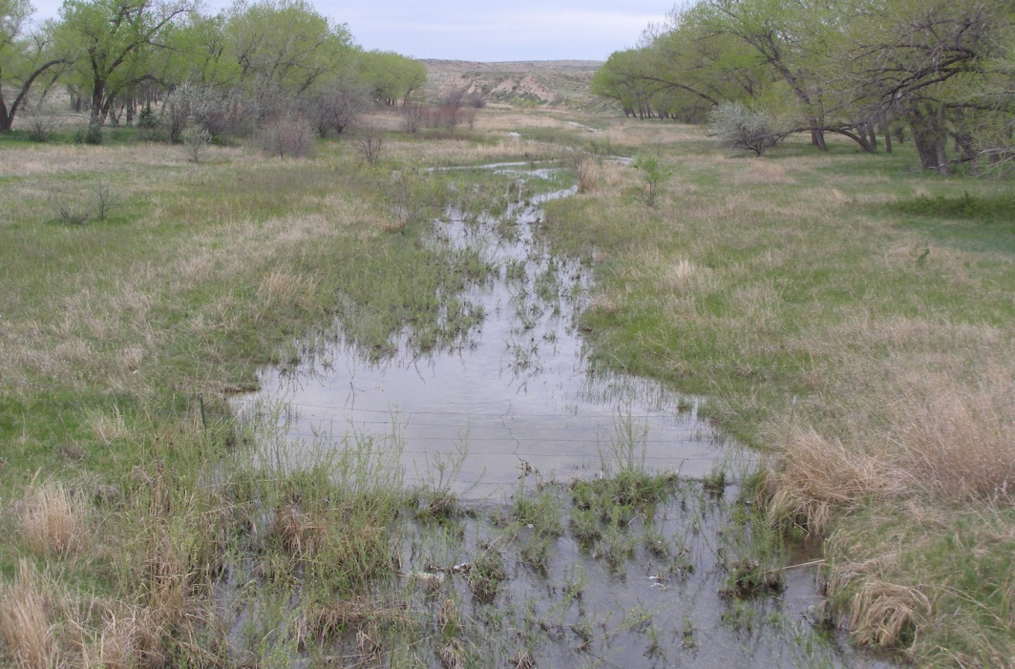
The Republican River Water Conservation District purchases surface water rights in the three tributaries to conserve surface water
for credit on the Compact.

Slide 32
Conservation Programs:
The District promotes conservation through voluntary participation.
By utilizing federal programs, the District has brought in millions of federal dollars to offer financial incentives to producers.
Water right owners may voluntarily retire their water rights to reduce consumptive use to the stream flows.
These water retirements reinforce the District’s efforts to conserve the Ogallala Aquifer for future generations.

Slide 33
There are two Conservation Programs available:
CREP
Permanent retirement of water right
Acres cannot be farmed – must be planted to grass
Land must have been irrigated 4 of the 6 years
Payment level is determined by location of the well
Payments to landowner is from FSA & RRWCD
EQIP
Permanent retirement of water right
Acres may be dryland farmed
Land must have been irrigated 2 of the last 5 years
Payment is dependent on location of the well
Payments to landowner from NRCS & RRWCD

Slide 34
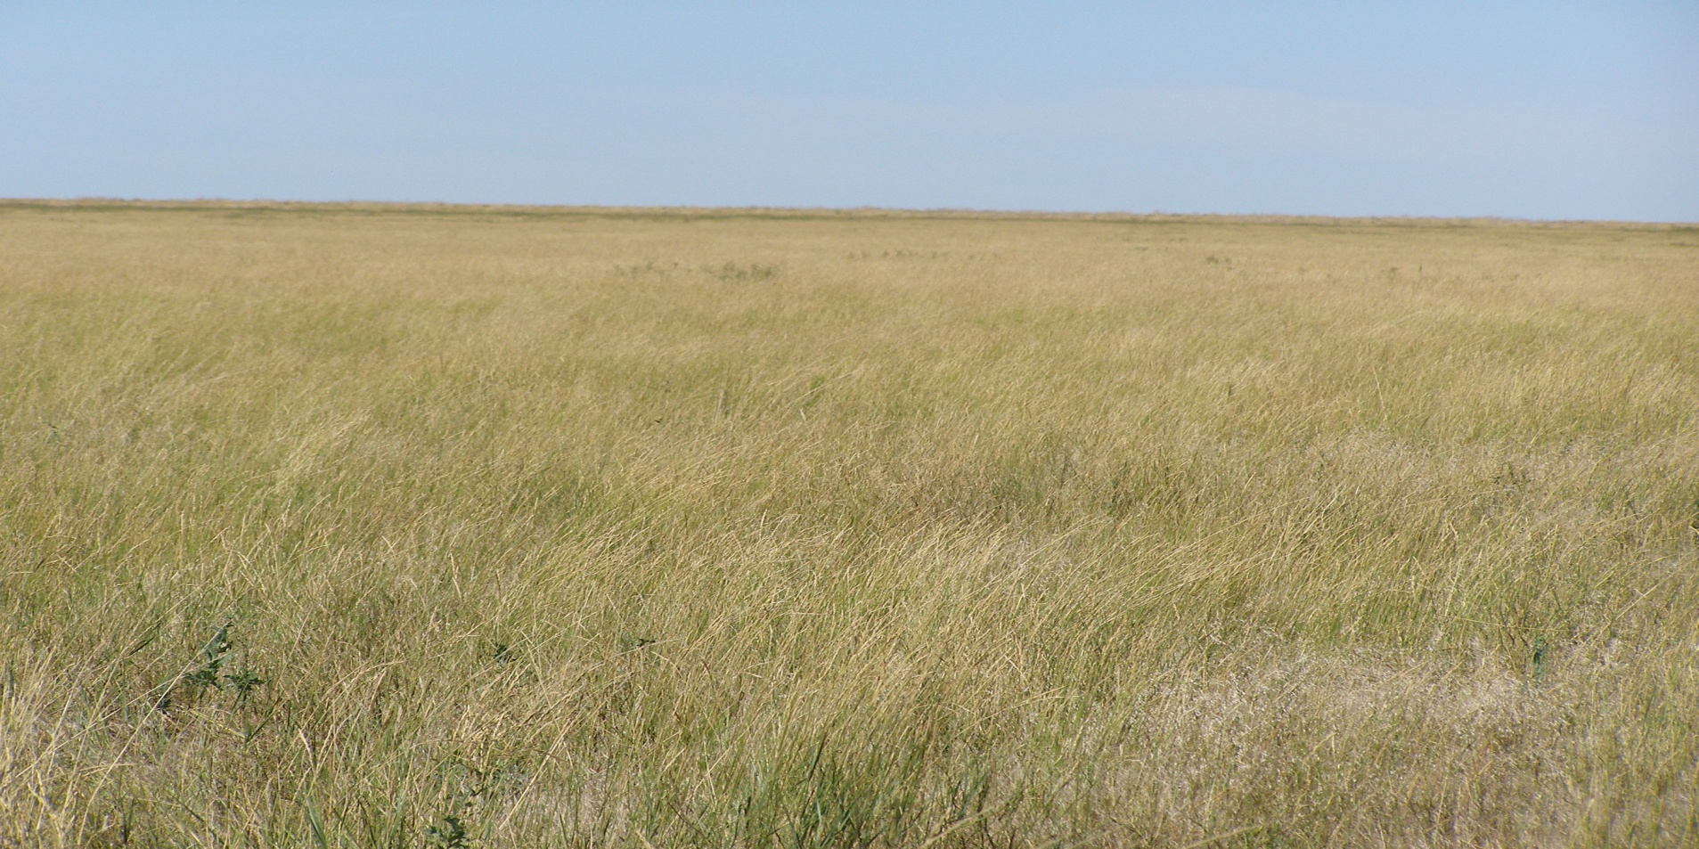
CREP
CREP acres which were formerly irrigated by a large capacity well. The landowner
voluntarily entered into CREP contract , drilled grass seed, used the irrigation well
to establish ground cover and then cancelled the water right and capped off the well. The landowner receives payments from FSA & the RRWCD for the CREP contract.

Slide 35
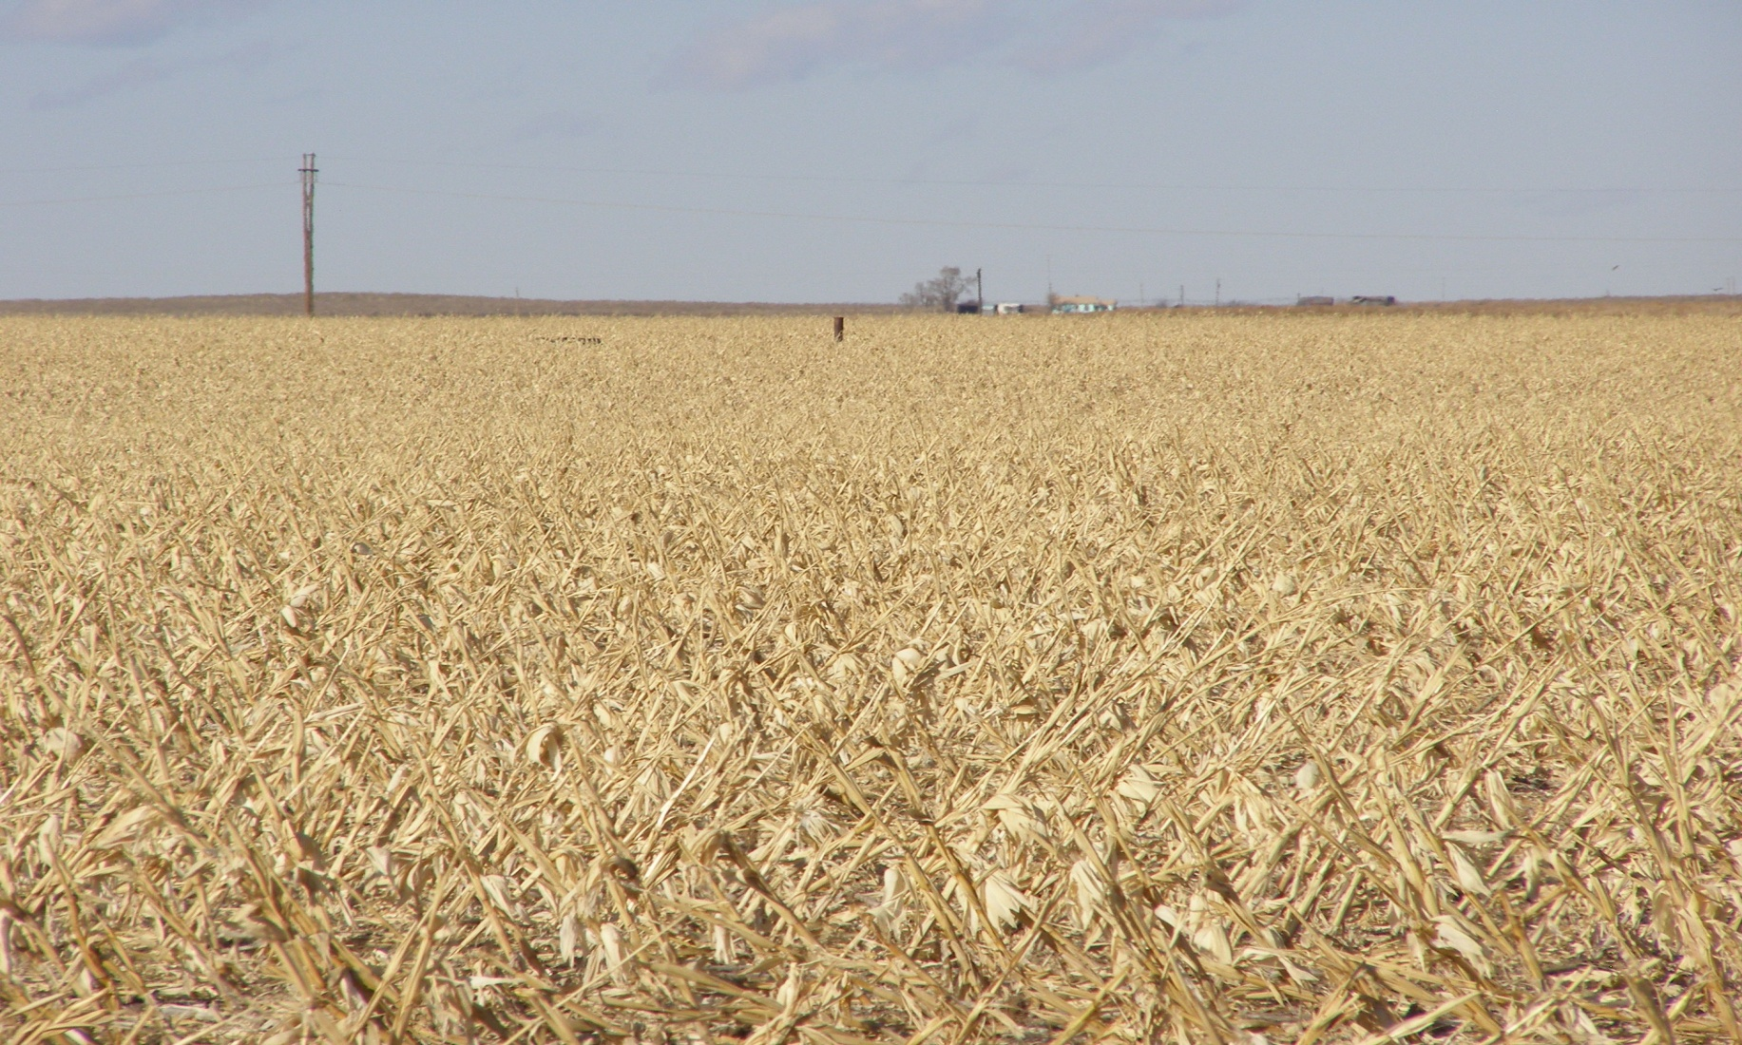
EQIP
Harvested dryland corn crop on EQIP acres. Photo shows disabled well which has been permanently retired.

Slide 36
Colorado must be in compliance with the Republican River Compact in a two-way test:
The State as a whole (all of Colorado that is in the Basin)
Each tributary (the North Fork, the Arikaree and the South Fork) must be in compact compliance

Slide 37
The South Fork
Bonny Reservoir
The State of Colorado is charged for the evaporation rate and seepage on Bonny Reservoir.
Bonny Reservoir is the answer to Colorado reaching compliance on the South Fork of the Republican River
Kansas will not negotiate with Colorado to find a resolution that will release Colorado from the evaporative charges on Bonny Reservoir

Slide 38
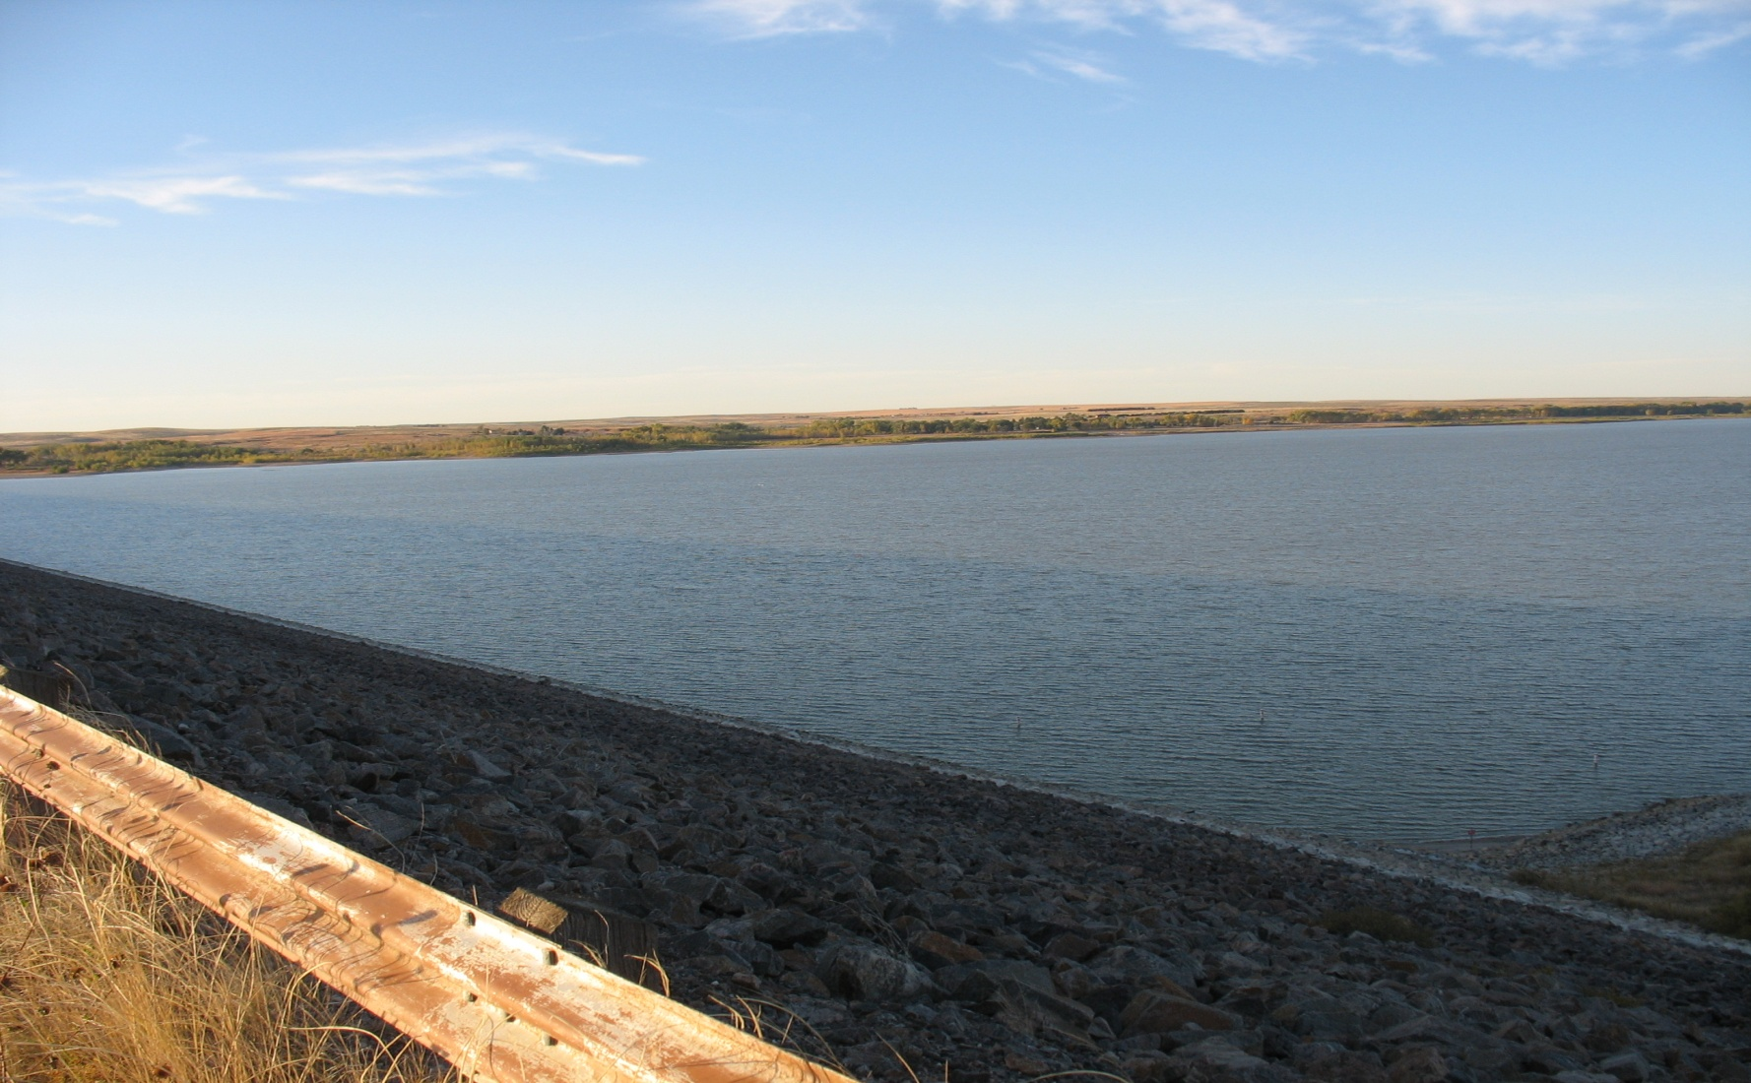
Dick Wolfe, State Engineer of the Colorado Division of Water Resources
orders the Bureau of Land Reclamation
to drain Bonny Reservoir
on September 20, 2011

Slide 39
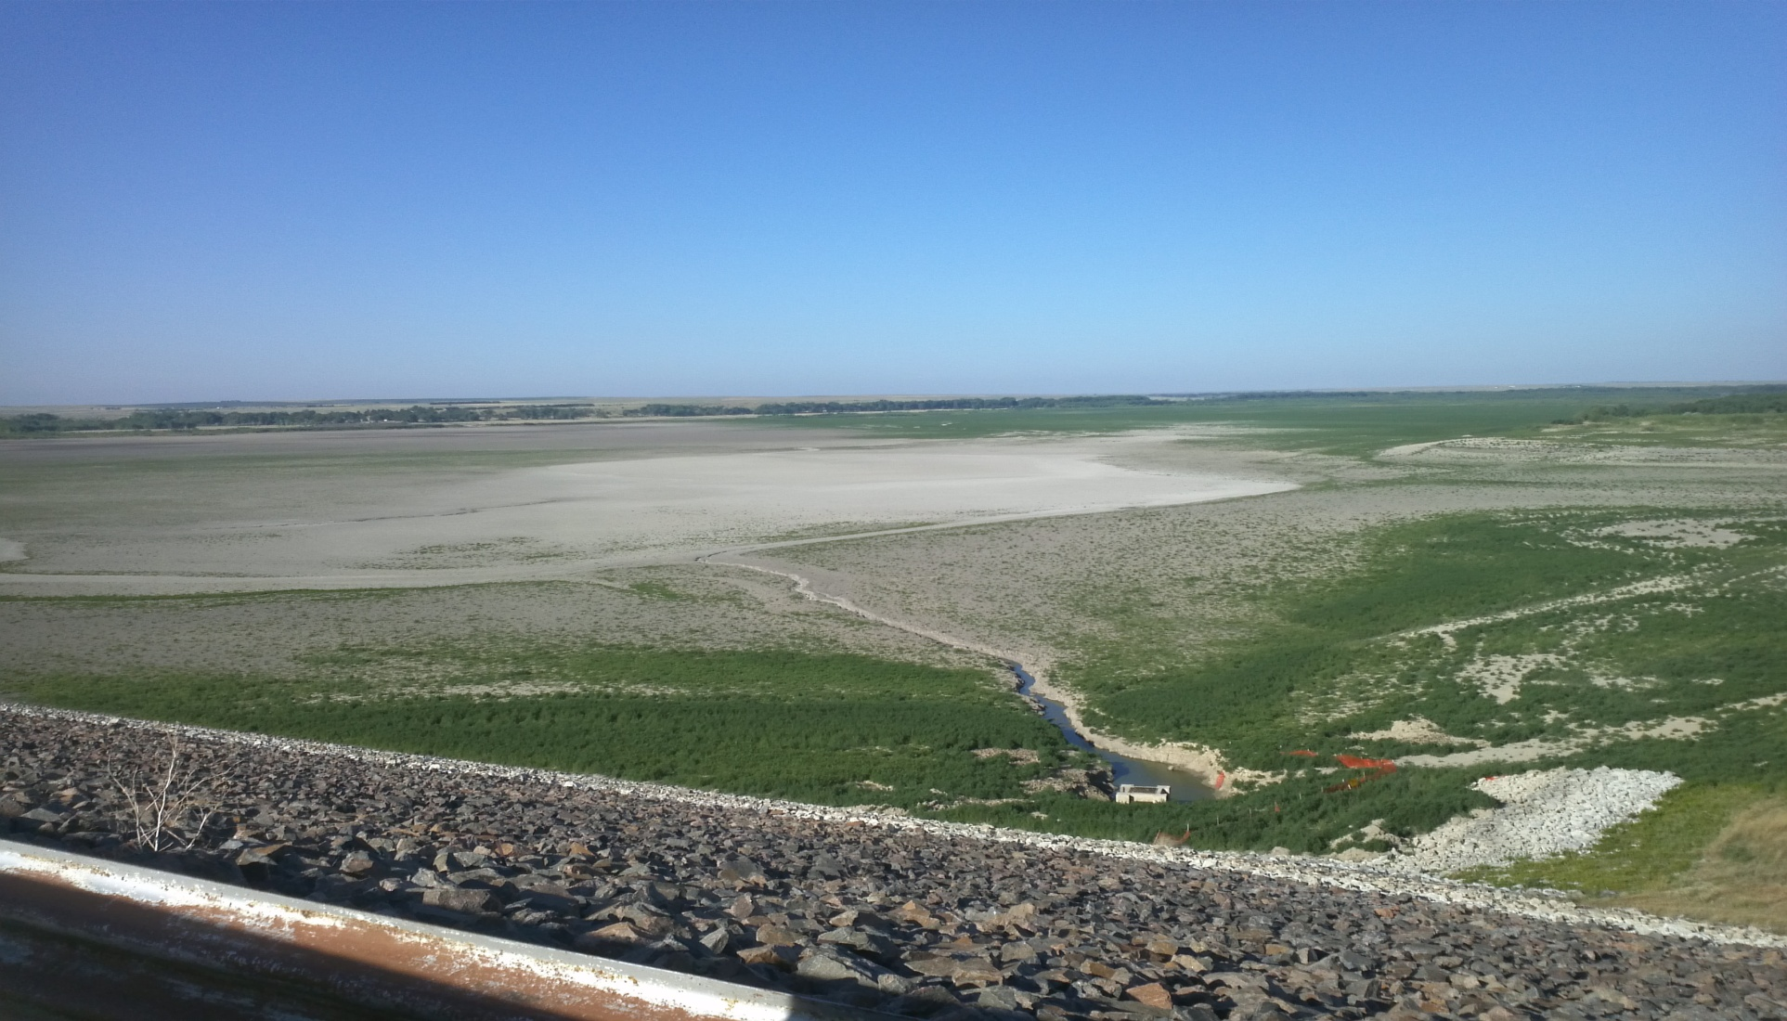
In May 2012, Dick Wolfe declares Bonny Reservoir is completely drained and it’s status is considered a flow-through for the South Fork of the Republican River

Slide 40
The Arikaree River
Due to the limited amount of water
available in this tributary
Colorado
is in compliance
with the
Republican River Compact
in this area

Slide 41
The North Fork
Current focus of the RRWCD is to reach compact compliance through a locally funded pipeline project on the North Fork of the Republican River.
The water source for the pipeline comes from 58 irrigation wells. Pumping is limited to historic consumptive use.

Slide 42
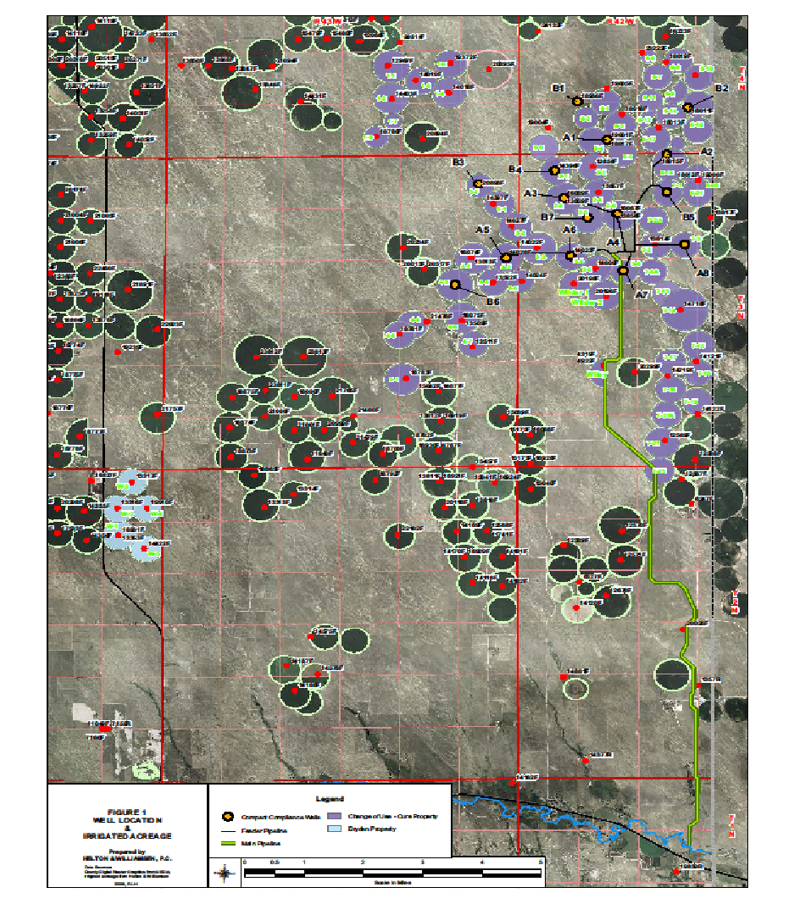

Slide 43
During the quarterly Board meeting on
July 9, 2011
The Board of Directors voted to
build the
Republican River Water Conservation District
Compact Compliance Pipeline

Slide 44
GEI Consultants, Inc, was selected as the pipeline engineering firm
Eleven companies submitted bids for the pipeline construction.
Garney Construction is awarded the general construction contract
Local and regional subcontractors were selected by Garney Construction

Slide 45
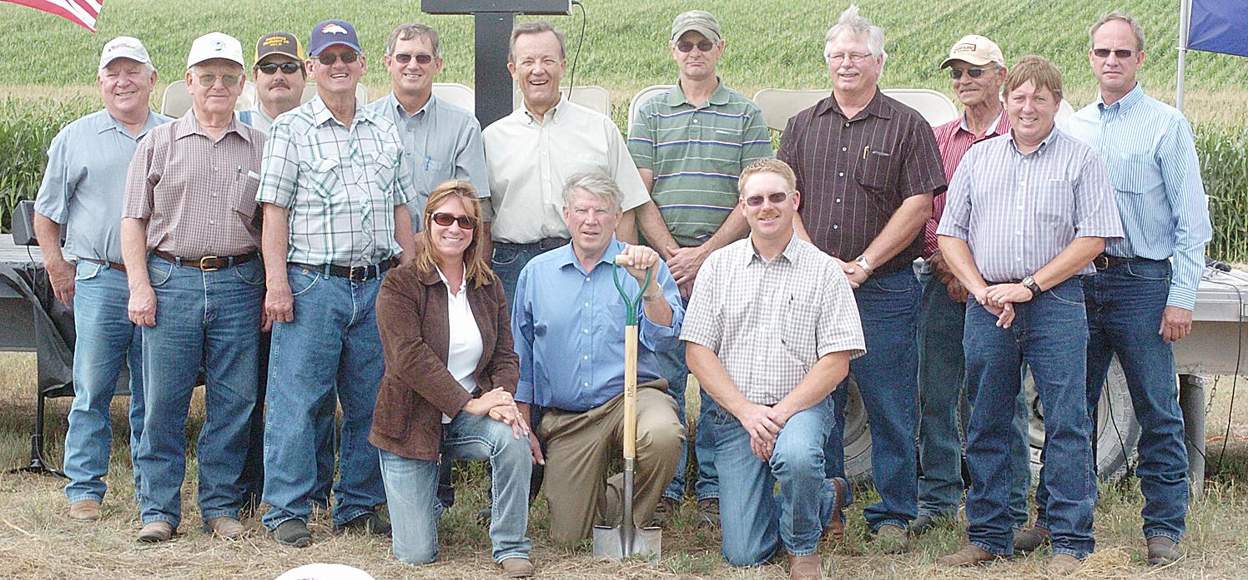
RRWCD Compact Compliance Pipeline
Groundbreaking Ceremony
August 29, 2011

Slide 46
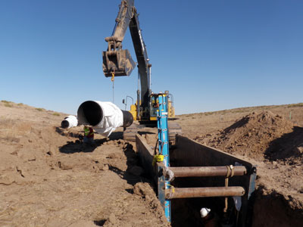
Garney started construction on September 14, 2011. The main transmission line is compiled of 30”, 36” and 42” pipe

Slide 47
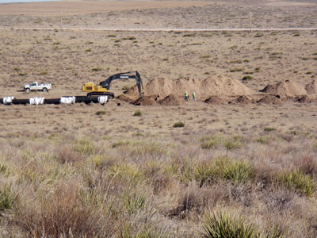
The twelve mile pipeline is installed through the sand hills in eastern Yuma County

Slide 48
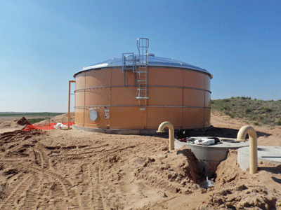
Eight irrigation wells – each capable of pumping 1600 – 2000 gallons
per minute will pump water into a 140,000 gallon collection tank. Water
from the tank will gravity flow 12 miles south to the outfall structure for delivery into the North Fork of the Republican River.

Slide 49
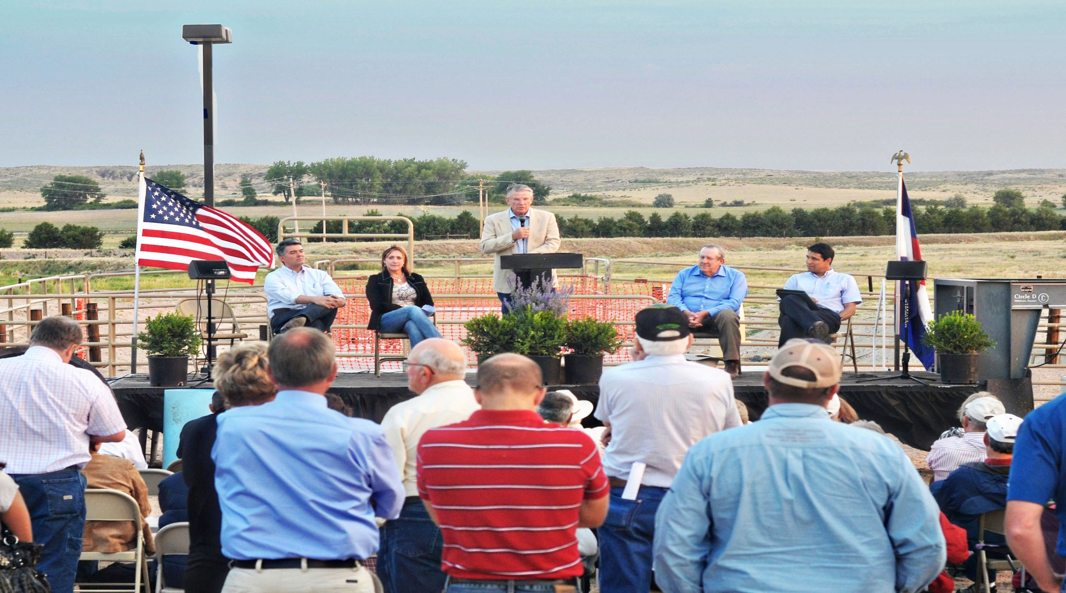
Dedication Ceremony of the Compact Compliance Pipeline held at the Pipeline Outfall Structure
on August 16, 2012

Slide 50
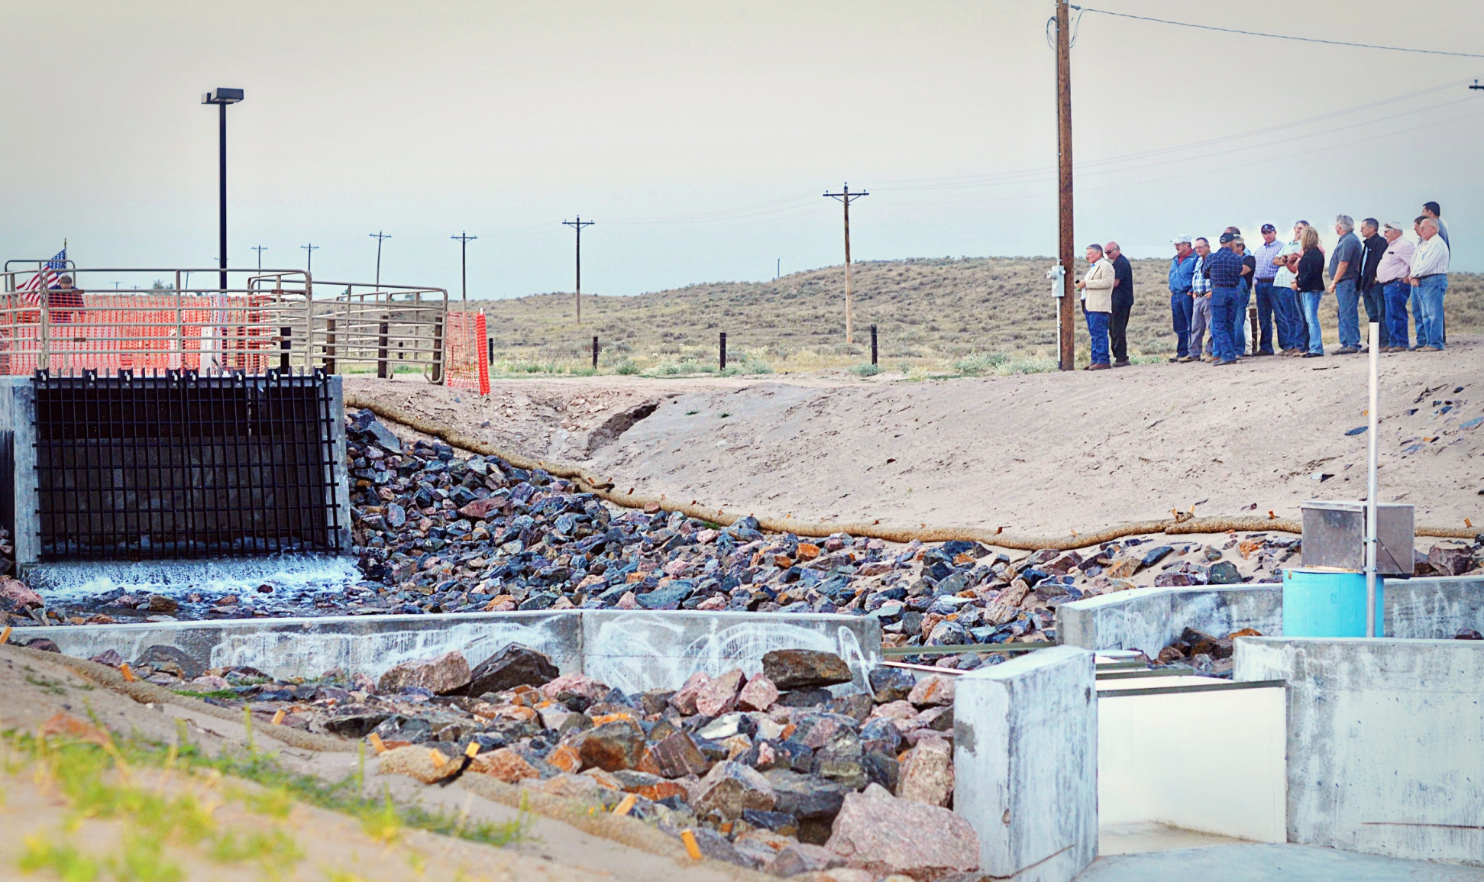
Current and former Board members and Administration watch as the water flows
from the pipeline outfall into a channel which delivers the water into the
North Fork of the Republican River

Slide 51
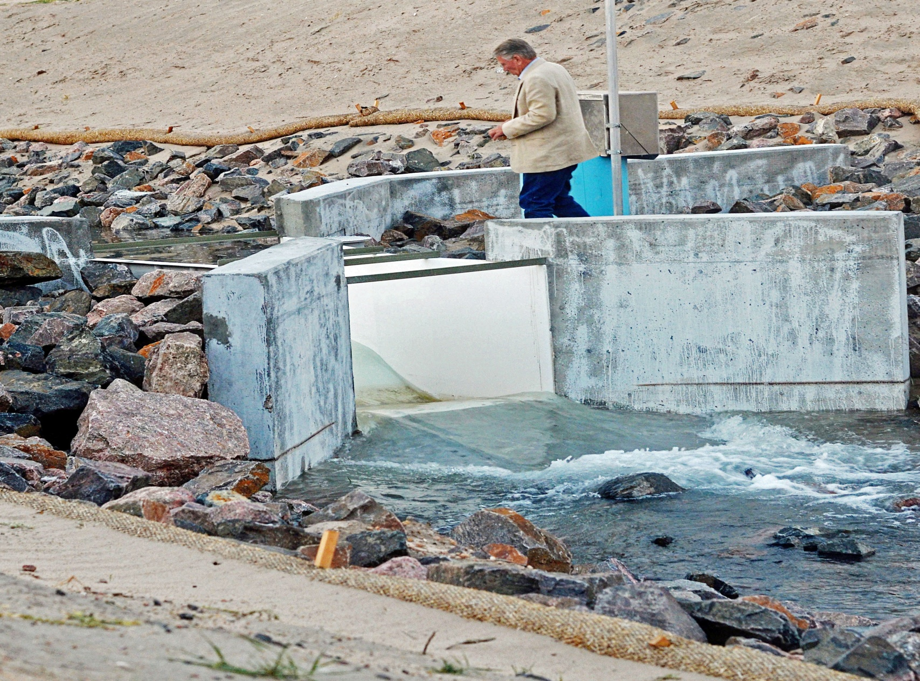
In a bittersweet moment President Coryell watches the delivery of groundwater moving through the parshall flume next to the Sutron Gage which Colorado uses to record the measurement of water delivered by the Compact Compliance Pipeline

Slide 52
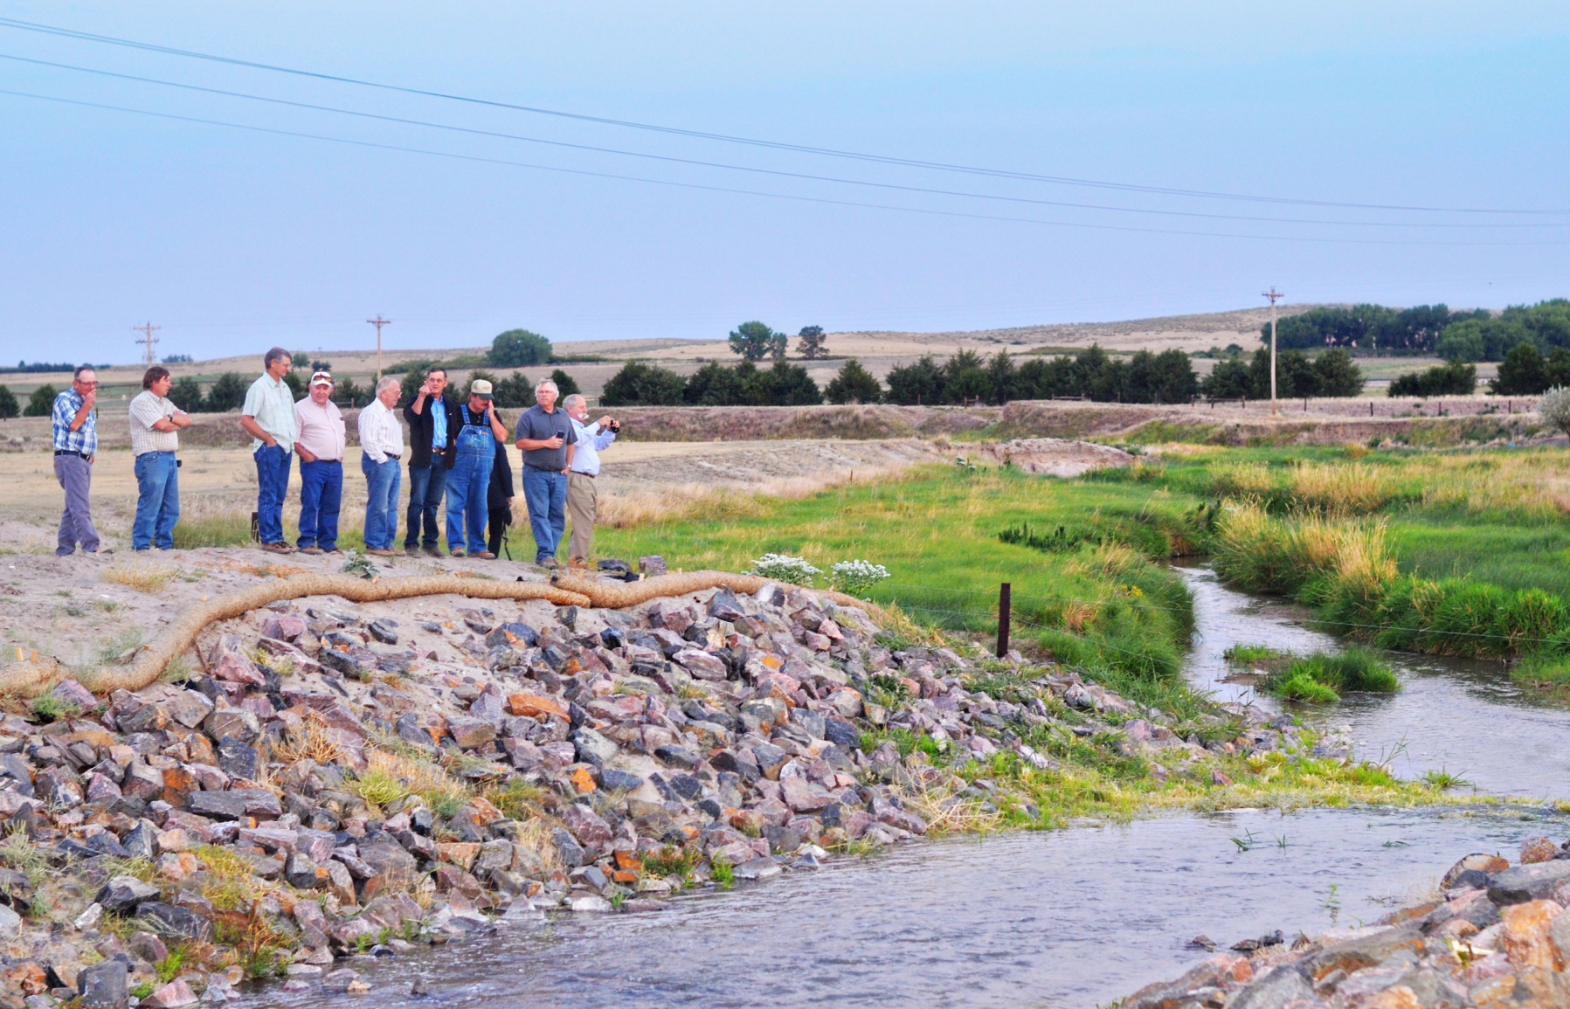
RRWCD Board members watching the water leaving the outfall channel and flowing into the river.

Slide 53
Construction of the Compact Compliance Pipeline has been completed. The pipeline is available for use in 2013.
Colorado has received approval for the delivery of groundwater from Nebraska and Kansas.
The Sandhills Groundwater Mgmt District approved 500 AF for testing the pipeline in 2012 but will not allow export of water in future until CO and KS agree on amount of credit CO will receive for delivery of water

Slide 54
The State as a whole…
Through the State of Colorado
Draining Bonny Reservoir
Negotiating the Compact with Nebraska and Kansas
And the actions of the RRWCD:
Conservation Programs; CREP & EQIP/AWEP
Purchasing Surface Water Rights
Compact Compliance Pipeline
…by working together, Colorado will
be in compliance with the
Republican River Compact

Slide 55
The next step for the RRWCD?
Options are being considered by the Board of Directors

Slide 56
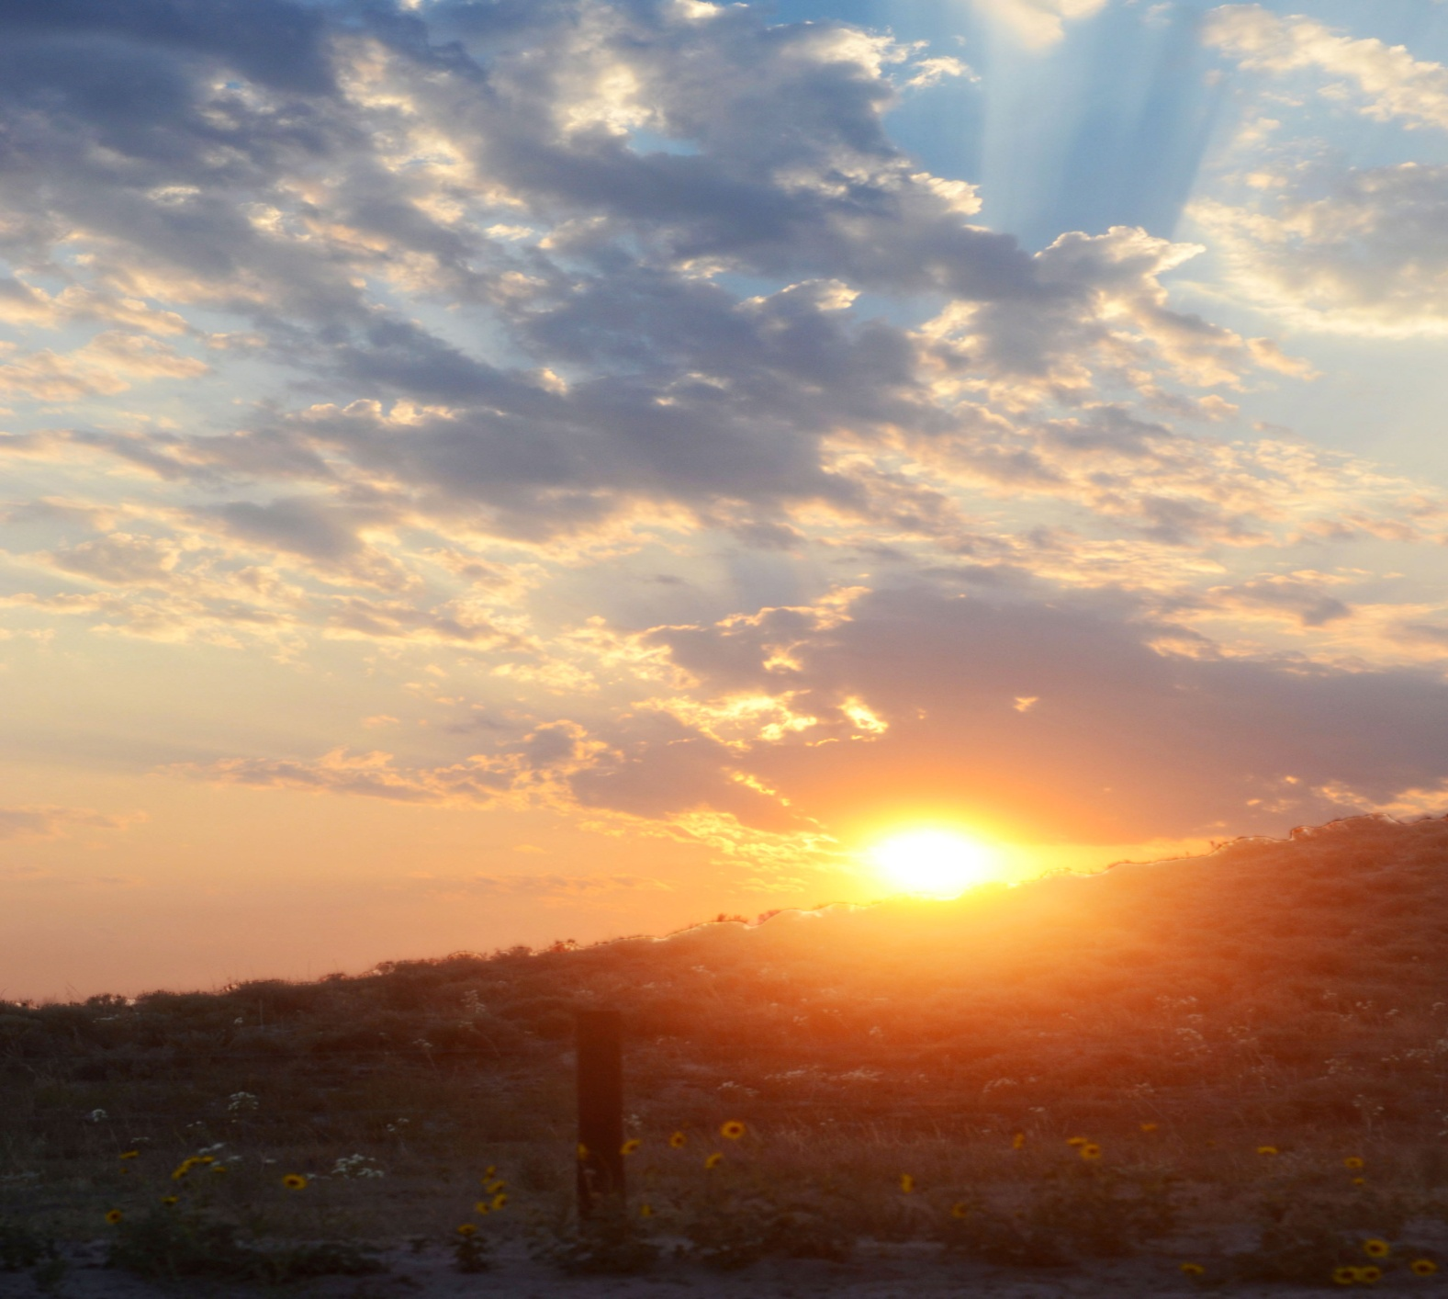
Any questions?
Please contact us
970–332-3552
info@rrwcd.com

