Slide 1
CREP
RRWCD

Slide 2
CREP
The Republican River Conservation Reserve Enhancement Program (CREP) is a Conservation Reserve Program (CRP) through the Farm Services Agency (FSA)
  Water right is permanently retired, and a grass habitat is established on the land for the 15 years of the contract.
  The applicant may apply up to 6 inches of water in the first 12 months of contract to establish vegetation. After the grass habitat is approved by the NRCS, the water right for the well is cancelled.
  The land may be used for grazing or dryland farming after the 15-year contract expires.

Slide 3
FSA Requirements
Start at the FSA office
The land being enrolled in the program must have been
  Irrigated 4 out of the last 6 years
  Be within the RRWCD boundary
  Be irrigated more than 6” per acre
  Be owned by the applicant for more than one year.

Slide 4
RRWCD Required Documents
Copy of the well permit
Copy of the deed for the land where the well is located
If the applicant is a company/corporation the applicant must provide corporate paperwork showing the members of the company/corporation
Documentation authorizing the applicant the legal right to sign on behalf of another person or entity
The previous 6 years of FSA-578 forms and corresponding maps showing the acres certified as irrigated land by the well
Ownership and Encumbrance Memorandum from the abstract office for the land irrigated by the well
The RRWCD office will also request assessed irrigated acres from the County Assessor
Notes:
Yes you really have to have paperwork showing members of the corporation
Always previous 6 years
Lien on paperwork, O and E Memorandum, third party looks into it and says actually there is a lien
The abstract office is the third party

Slide 5
Determination of acres
The RRWCD pays on the lesser of three values when determining the number of irrigated acres:
  Number of acres allowed on the well permit
  Number of acres irrigated by the well as assessed by the County Assessor the previous year
  Number of irrigated acres the last six years according to the FSA cropping records

Slide 6
Payment calculation
The amount to be paid by the RRWCD for the contract is determined by multiplying the determined number of irrigated acres for the contract by the rate paid per acre for the well, depending on the location of the well.
    *Rate paid by FSA varies by county*
If there is a lien on the property, the payment from the RRWCD will include the name of the applicant and the name of the lien holder as the payee.

Slide 7
RRwcd Payments
The RRWCD CREP rates vary due to the location of the water right according to the following descriptions
  Surface water throughout the entire RRWCD area
  Wells inside the SF Focus Zone and less than 1 mile from the South Fork Republican River
  Wells inside the SF Focus Zone and more than 1 mile from the South Fork Republican River
  Wells less than one mile of the North Fork Republican River and the Arikaree River
  Wells outside the South Fork Republican Focus Zone and more than 1 mile from the North Fork Republican River and the Arikaree River
Notes:
The RRWCD payments vary by location because the State of Colorado entered into an agreement with Kansas to try

Slide 8
Next steps
The vegetation required for each CREP contract is determined by the local NRCS office.
  The producer may use up to 6 inches of water within the first 12 months of the contract to assist in establishing the cover crop.
  After the NRCS approves vegetation, they notify the FSA, who forwards the approval to the RRWCD. The RRWCD and the participant completes the form cancelling the final permit for the large capacity well and submits the form to the CO Division of Water Resources.
    The well owner may choose to downsize the well, the application form is completed with the RRWCD.
  Upon receiving the Order of the Ground Water Commission that the final permit has been cancelled the RRWCD notifies the FSA that the cancellation has been approved.

Slide 9
Water use Fee
The RRWCD Water Use Fee is no longer assessed beginning the first full year of non-irrigation. Applying the 6 inches of water within the first 12 months to establish the cover crop is not considered irrigation when assessing the water use fees.
However, the land will be assessed by the County Assessor as irrigated land for property tax purposes until the end of the 15-year CREP contract.
Notes:
As long as you are receiving payment from FSA (federal funds) for a conservation program, you are required to pay irrigated land taxes to the county treasurer.

Slide 10
 |  | A | B | C | D | E
 |  | Surface Water entire RRWCD area | < 1 mile South Fork & INSIDE Focus Zone | > 1 mile South Fork & within South Fork Focus Zone | < 1 mile North Fork & Arikaree | > 1 mile North Fork, Arikaree - Not in SF Focus Zone
 | FSA Grass Install Cost Share | 50% | 50% | 50% | 50% | 50%
 | Payment per acre per year
 | FSA | $180.00 | $180.00 | $180.00 | $180.00 | $180.00
 | RRWCD | $300.00 | $55.00 | $35.00 | $20.00 | $6.00
 | Total paid per acre for 15-year CREP contract
 | Total FSA | $2,700.00 | $2,700.00 | $2,700.00 | $2,700.00 | $2,700.00
 | Total RRWCD | $4,500.00 | $825.00 | $525.00 | $300.00 | $90.00
 | Total $ to Producer | $7,200.00 | $3,525.00 | $3,225.00 | $3,000.00 | $2,790.00

Slide 12
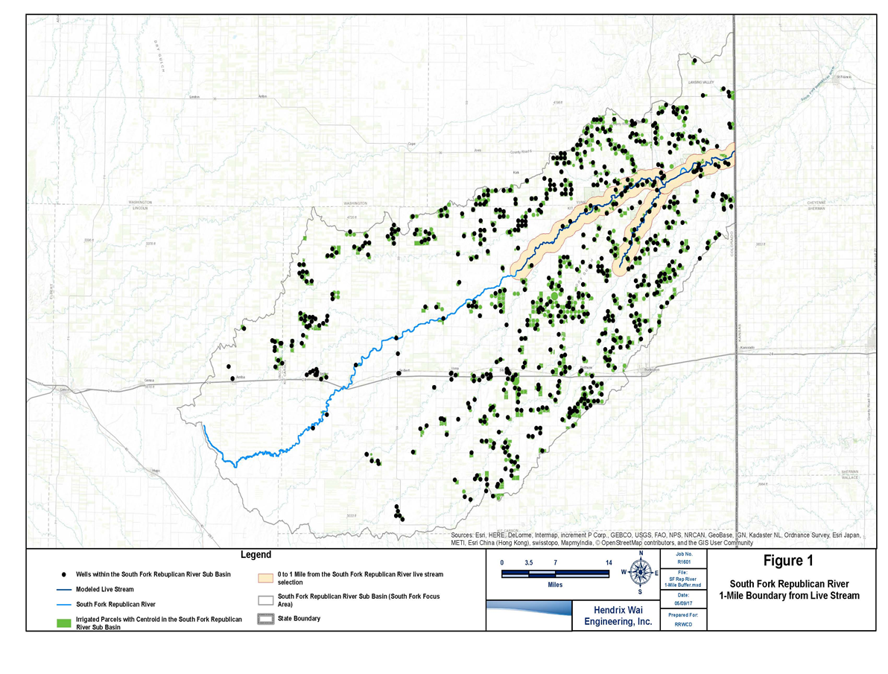
Notes:
This map shows the 1-mile boundary from Live stream flow of the south fork. In 2002 the yellow shows live stream flow.

Slide 15
RRWCD vs. Republican River domain boundary

Slide 16
