Slide 1

Conservation
Get involved—Republicanriver.com

Slide 2
Republican River Water Conservation District
South Fork Focus Zone

Slide 3

There is an elephant in the room… and its name is…
… the depleting aquifer

Slide 5
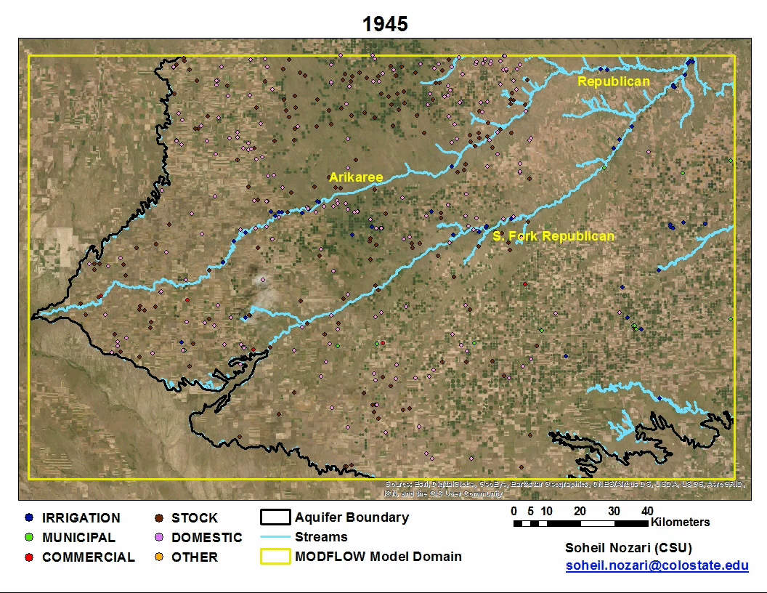

Slide 6
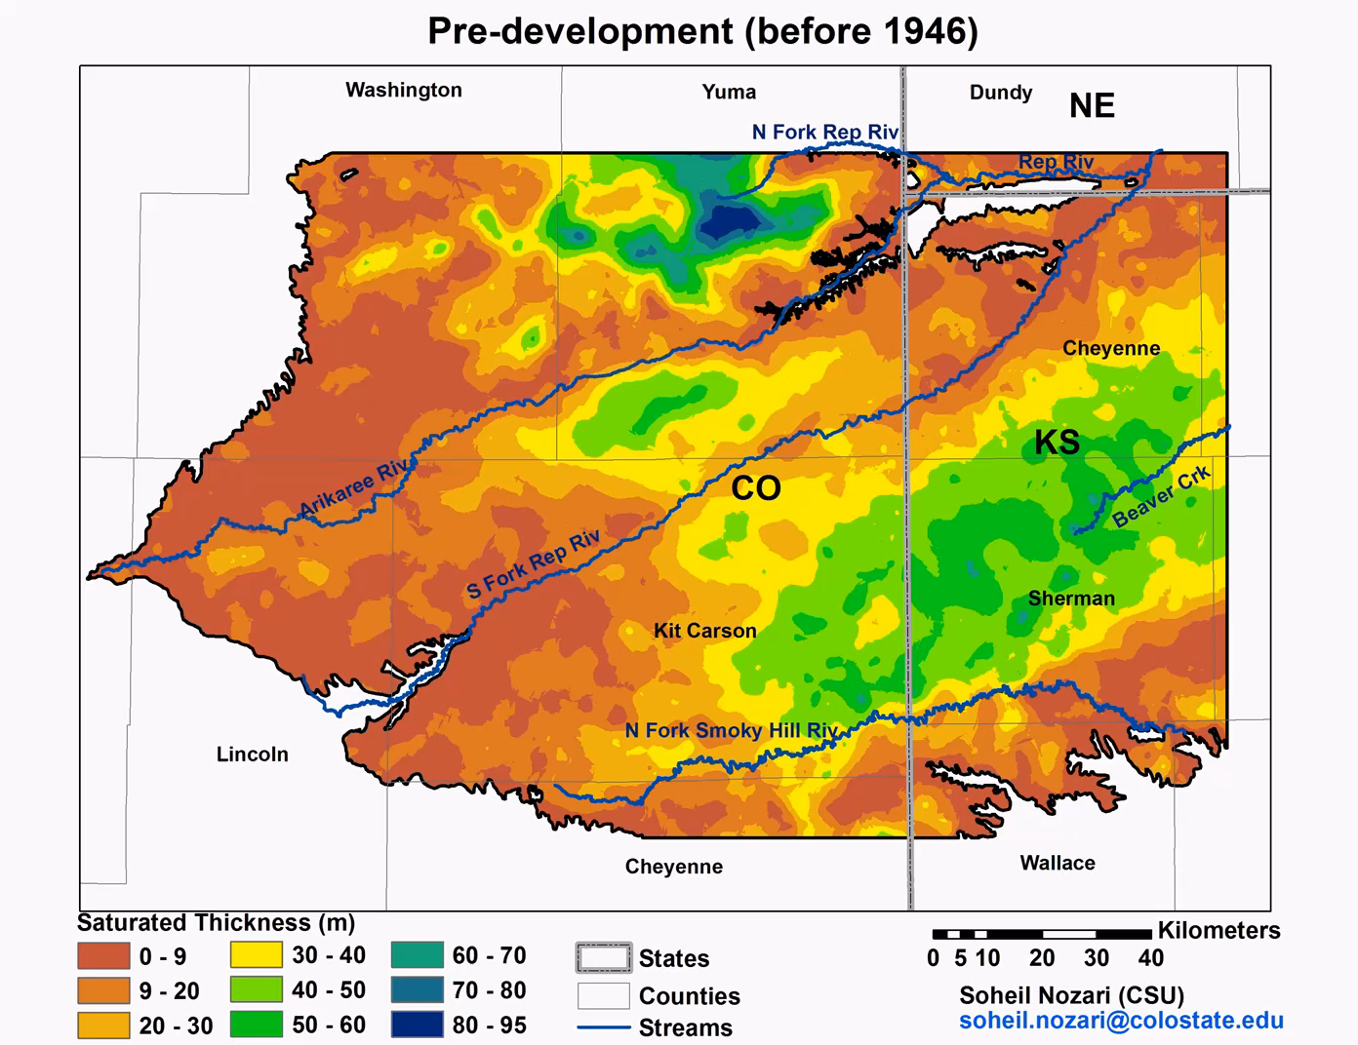

Slide 7
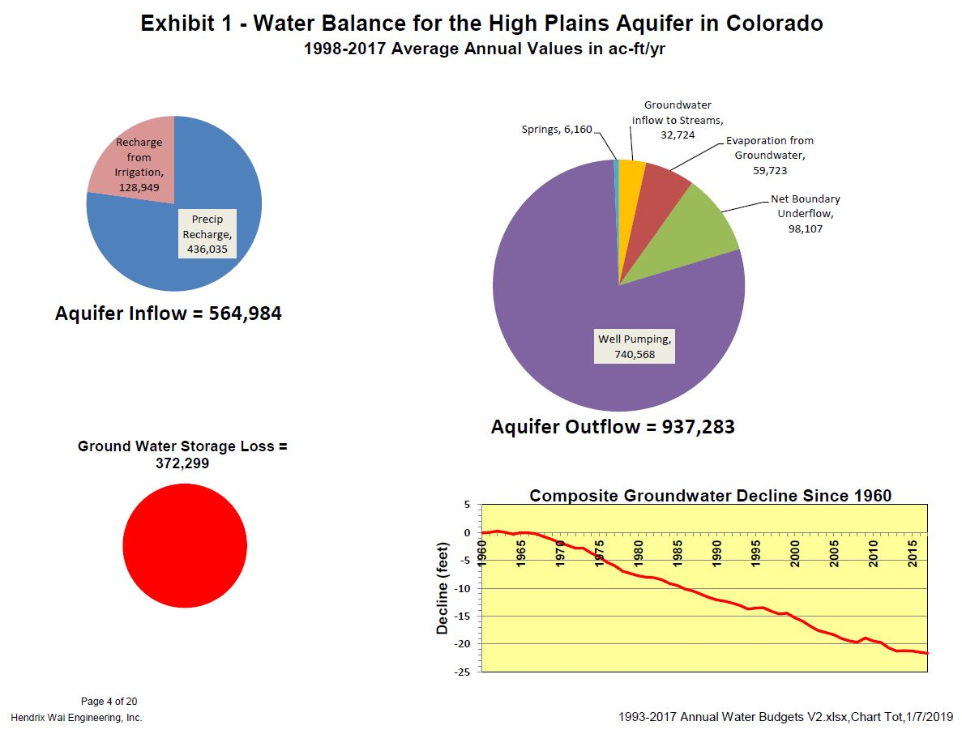

Slide 8
South Fork Republican near Benkelman, NE
10-year Averages | 1960-1969 | 30,943.59
 | 1970-1979 | 18,650.85
 | 1980-1989 | 16,937.68
 | 1990-1999 | 14,002.21
 | 2000-2009 | 2,092.83
 | 2010-2019 | 4,460.21

Slide 9
Arikaree near Haigler, NE
10-year Averages | 1960-1969 | 15,676.69
 | 1970-1979 | 8,762.01
 | 1980-1989 | 8,001.85
 | 1990-1999 | 6,144.57
 | 2000-2009 | 1,103.32
 | 2010-2019 | 711.35

Slide 10
North Fork at Colorado Nebraska Stateline
10-year Averages | 1960-1969 | 36,403.77
 | 1970-1979 | 28,969.91
 | 1980-1989 | 30,041.09
 | 1990-1999 | 25,544.27
 | 2000-2009 | 19,708.54 | Pipeline
 | 2010-2019 | 17,814.70 | 10374.33

Slide 11
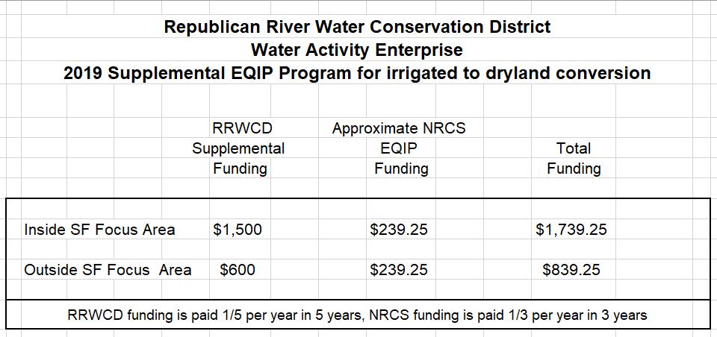
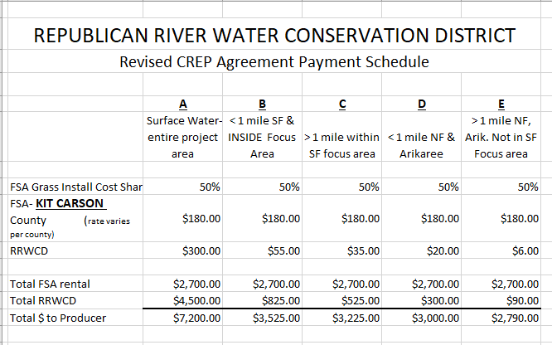
Conservation programs for permanent retirement of irrigation
Wells in the SFFZ are eligible for $200/irr. ac. incentive payment.

Slide 12
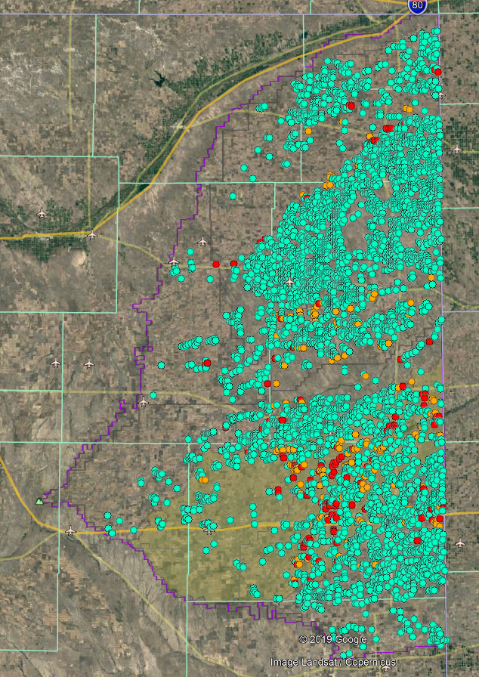
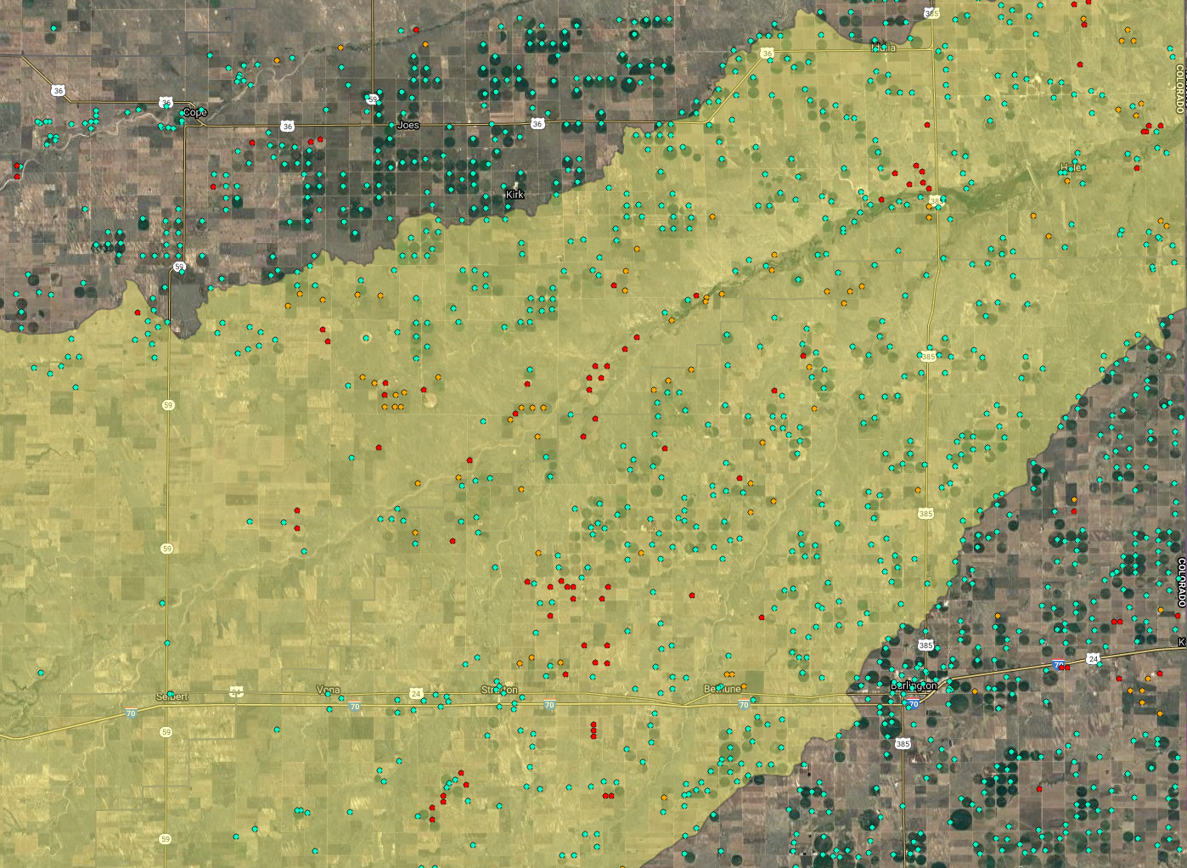
Go to RRWCD website: republicanriver.com to view this interactive map and zoom in for more detail.
Green dots—wells
Red dots—EQIP/OAI/AWEP
Orange dots—CREP

Slide 13
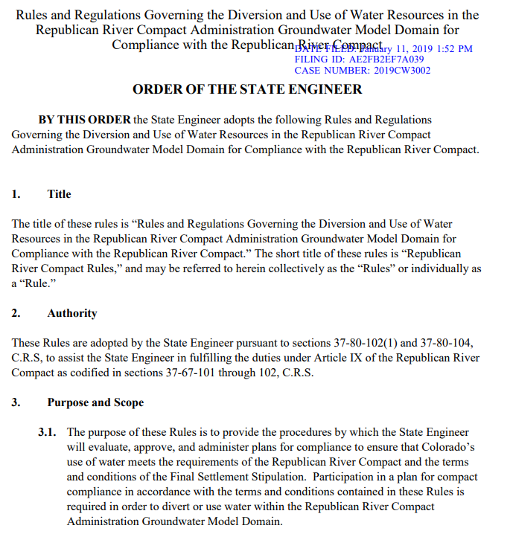
The Republican River Compact Water Use Rules provides the State Engineer the legal steps to curtail large capacity wells if the Basin is not in compliance with the compact.

Slide 14
The good news
WE are not out of time…
To avoid a catastrophe
We must continue seeking better efficiency
  Colorado Master Irrigator
  We can find new ways to use less water and still be profitable
  Retire water now
Purchase of surface water rights
  Work to get stream flow
  We must maximize return on water to preserve our economic health

Slide 15
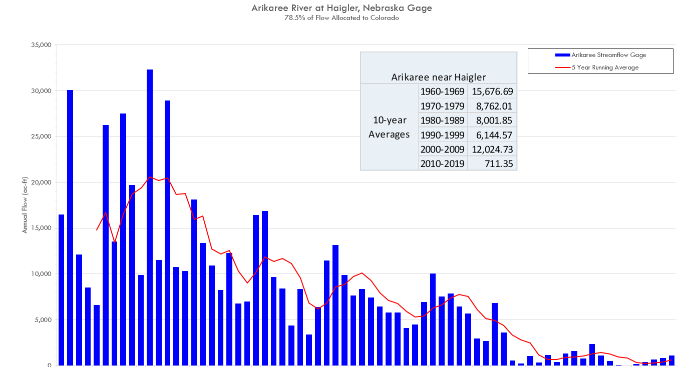
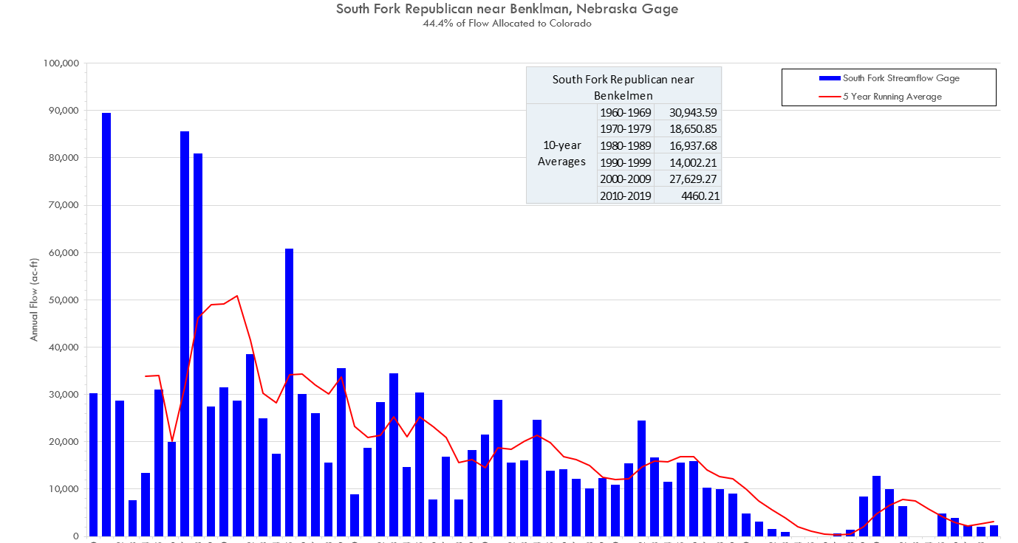
TRIBUTARY OPPORTUNITIES
We can get marginal increased flow in tributaries
Phreatophytes control and water retirement

Slide 16
Extend the life of the pipeline
The pipeline bought the basin a limited amount of time
A basin wide conservation plan will continue compact compliance
Impact of a 25% reduction in pumping to the compact obligation

Slide 17
What are we going to do?
GROUND WATER MANAGEMENT DISTRICTs have a choice to make—
  FORM A SPECIAL TASK FORCE
    1 MEMBER FROM EVERY DISTRICT AND OUTSIDE experts
    CREATE A COMPREHENSIVE WATER CONSERVATION PLAN FOR THE ENTIRE BASIN
    EVERY DISTRICT MUST AGREE ON the PLAN
  ASK THE RRWCD TO CREATE A CONSERVATION PLAN
    BY SIGNING A RESOLUTION AND SUPPORTING NECESSARY Statute CHANGES
  DO NOTHING
RRWCD WILL USE “POWER OF THE PURSE” TO encourage conservation
  Can’t ignore obligation to future compact compliance
  Will be forced to use existing statutory authority to maintain compliance
  Ultimately, we need to worried about our future and not just compact compliance
DO WE HAVE ANOTHER CHOICE?

Slide 18
JOINT EFFORT
Ground Water
Management Districts
RRWCD
Tools:
funding for conservation projects
assistance with public meetings
other ideas..?
Jurisdictional authority
Authority to gather funds for
conservation and compact
compliance
TASK FORCE
Elongate
the lifespan of the aquifer
and
our local communities

Slide 19
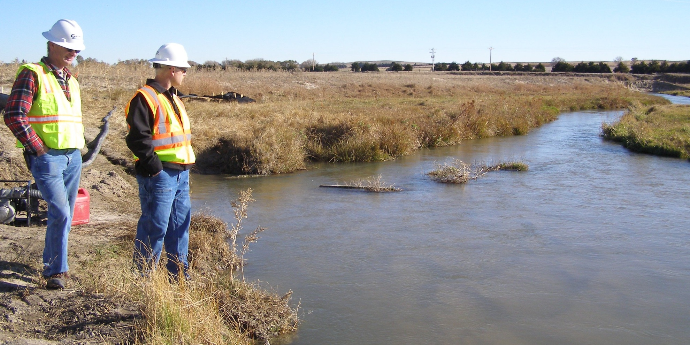

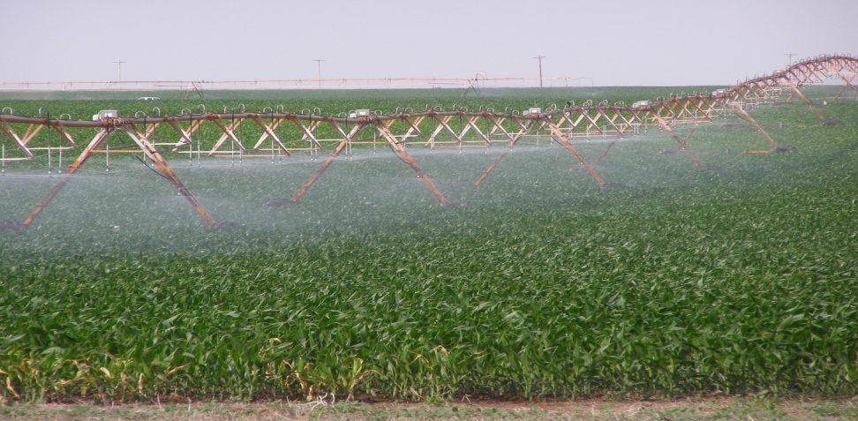
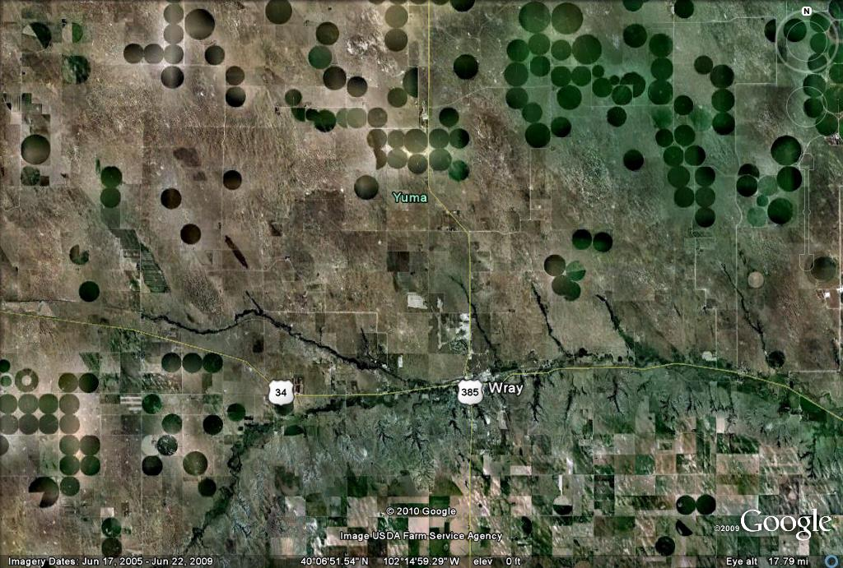

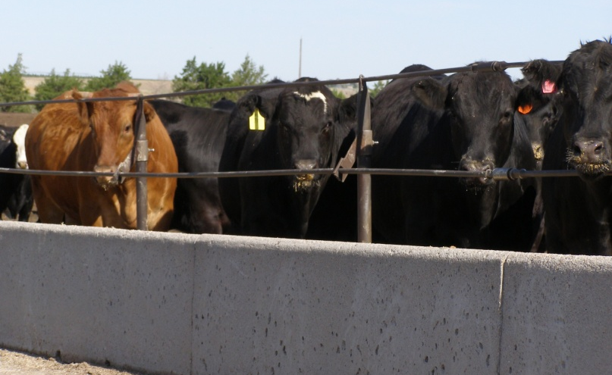
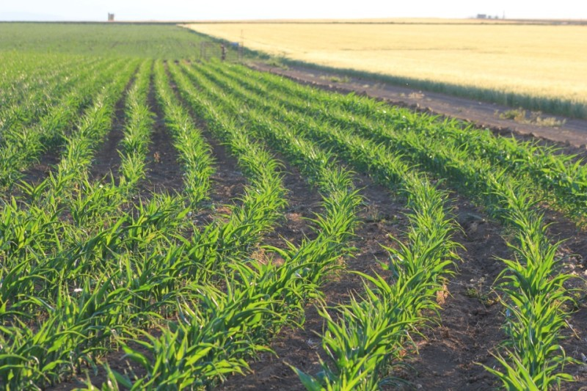
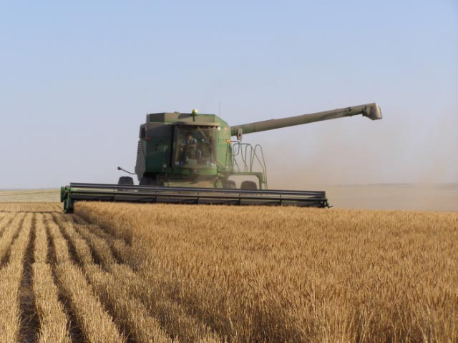
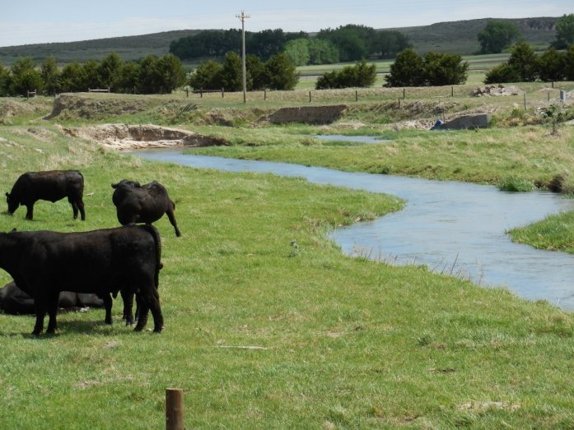
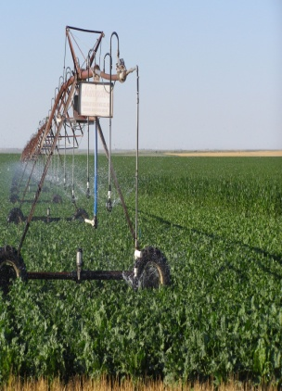

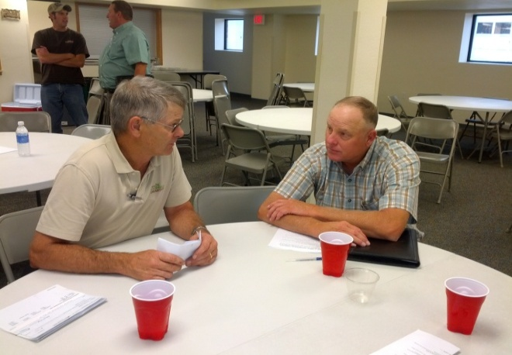

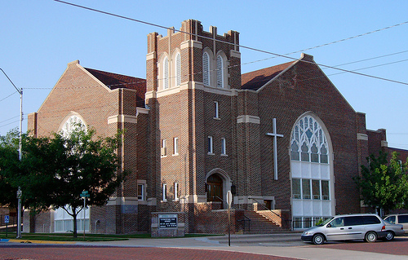

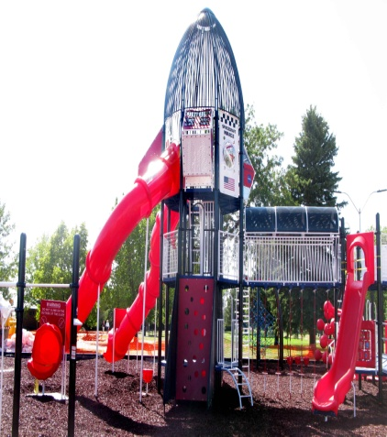

We need your help…. water touches all of us… we need each other to be successful

Slide 20
You cannot escape the responsibility of tomorrow by evading it today. Abraham Lincoln
Do the best you can until you know better. Then when you know better… Do better.
Maya Angelou

