Slide 1

Evaluation of the
Compact
Compliance
Pipeline
Looking at the present issues… and concerns about future expansions

Slide 2
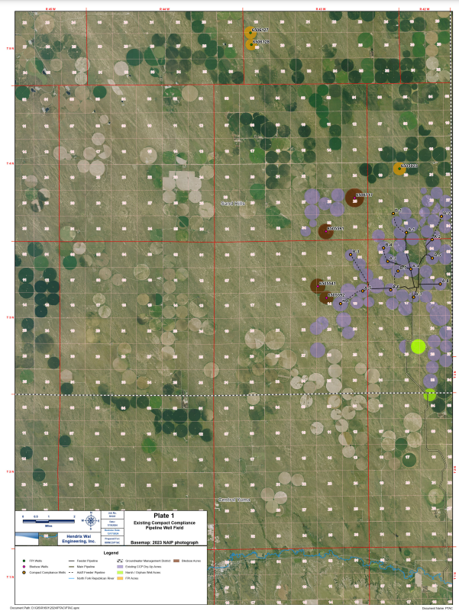
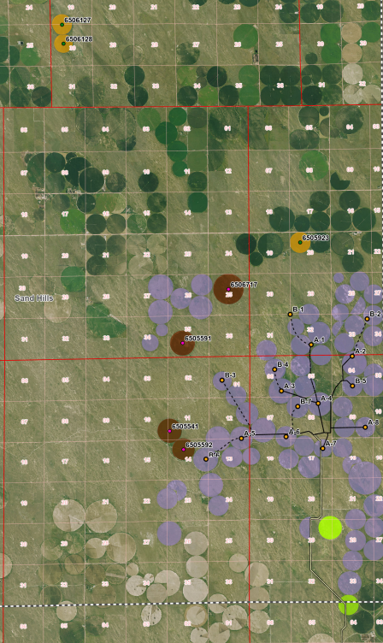
Compact Compliance Pipeline Wells

Slide 3
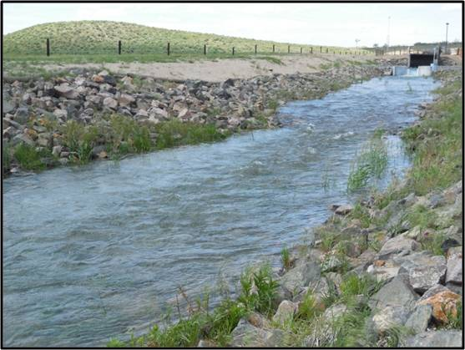
Keep in mind…
1. We currently operate the pipeline at a rate of 30 cfs or 59.5 AF per day.
2. That is max of our 8 wells we currently operate.
3. The pipeline has the capacity to operate at 45 cfs or 89.25 AF per day.
4. The CCP has an annual maximum capacity of 25,000 AF, if operated 280 days per year at 45 CFS.
5. The well field will have to be equipped to physically deliver it.

Slide 4
CCP ANALYSIS
Purchases | AF | $/AF | Total cost
Cure / Dryden | 12,858 | $3,610 | $50,000,000
Orphan well | 201 | $3,610
Larson / Harsh | 228 | $3,508 | $800,000
Bledsoe (4 wells) | 1,117
FPI (3 wells) | 522 | $5,200 | $2,717,000
Total of all POTENTIAL water rights | 14,926 | $3,585 | $53,517,000
Phase I construction - cost to build pipeline |  |  | $20,000,000,
Total of Water and Phase I construction |  |  | $73,517,000
Note: This total amount is accounted for in RRWCD Budget

Slide 5
PHASE II EXPANSION
Construction items | Nr wells | Cost / well | Total costs
Lateral Piping to connect B1, B2, B3, B6, |  |  | $7,440,000
Engineering costs | 4 | $25,000 | $100,000
Motors and pumps | 4 | $118,000 | $472,000
Easement costs (33,250 ft x $24 / ft) 6.3 miles |  | N/A | $0
Scada System / electronics | 4 | $121,325 | $485,300
Road construction |  |  | $100,000
Estimated Total for Phase II |  |  | $8,597,300

Slide 6
PHASE III - FUTURE EXPANSION
Construction items | Nr wells or AF | Cost/well or AF | Total costs
AF needed to max 25,000 | 10,074 | $5,200 | $52,384,800
Lateral Piping to connect future purchases (estimate) 4 Bledsoe wells, 3 FPI wells, future purchases/where? |  |  | $31,660,000
Engineering costs | 13 | $25,000 | $325,000
Motor and Pumps | 13 | $118,000 | $1,534,000
Easement for project (52,800 ft X $24) (10 mi) |  |  | $2,065,200
Scada System / electronics | 13 | $121,325 | $1,577,225
Road construction to wells |  |  | $250,000
Estimated Total for Phase III | 25,000 |  | $89,796,225
Estimated Grand Total to Max the CCP in future |  |  | $171,910,525

Slide 7
ANNUAL EXPENSES
Expenses | Nr wells | Cost each | Total
Phase I Electric Bill to operate 8 wells ($6,250 per well X 8 X 7 mo.) |  |  | $350,000
Phase II Electric Bill to operate 4 wells at above rate |  |  | $175,000
Phase III Electric Bill to operate 13 wells at above rate |  |  | $568,750
Pipeline manager |  |  | $75,000
Maintenance on 5 wells / year | 5 | $50,000 | $250,000
Estimated Annual cost Ownership & Maintenance in future |  |  | $1,418,750

Slide 8

Producers spending / pumping as much of appropriation as they want …..
RRWCD’s Compact Compliance Pipeline
$~~AF
$~~AF$~~AF$~~AF$~~AF$~~AF$~~AF
$ $ $ $ $ $ $ $ $ $ $ $ $ $ $ $
…then in the fall… producers report what they have spent /pumped
$~~AF$~~AF
$ $ $ $ $ $ $ $ $ $ $ $ $ $ $ $
Now the bank has to balance / cover everyone’s AF pumped

Slide 9

Conservation Approach
Status Quo Approach
You cannot escape the responsibility of tomorrow… by evading it today.
Abraham Lincoln

