Slide 1

The Ogallala Water Coordinated Agricultural Project
Lessons Learned Across State Lines
Meagan Schipanski and Amy Kremen
Department of Soil and Crop Sciences
Colorado State University
January 10, 2019
Republican River Water Conservation District

Slide 2
Outline
Reminder of who we are
Part 1. Lessons learned about practices and policies with potential to foster conservation and profitability
Part 2. Social values of water
Part 3. Evaluating policies and practice options
Notes:
Each state is different yet most are grappling with similar issues
Avoid the duplication of research efforts and leverage synergies
Build collaborative networks of researchers, producers, groundwater managers, industry

Slide 3
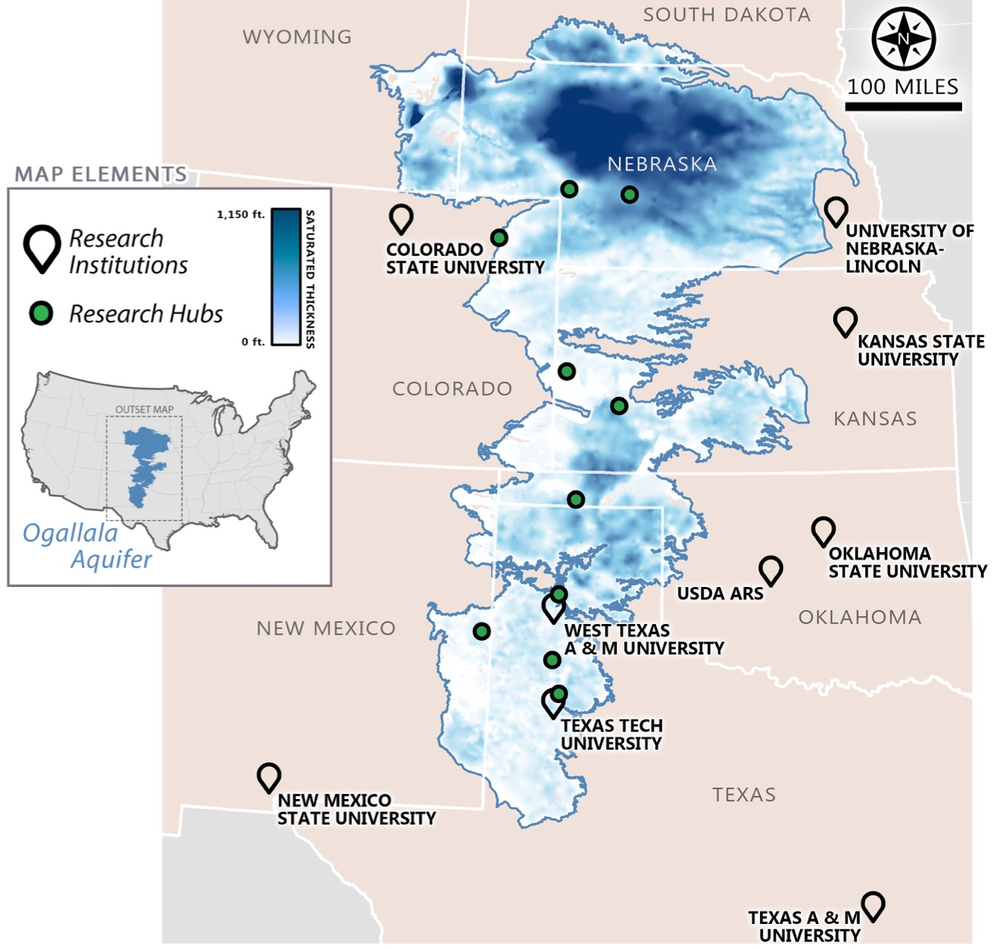
Our approach
Recognize that each state is different yet most are grappling with similar issues
Management is local: Work from the ground up with producers and groundwater management groups
Foster partnerships for innovation around water tech for conservation
Ask the difficult questions
L. Moore
Notes:
Each state is different yet most are grappling with similar issues
Avoid the duplication of research efforts and leverage synergies
Build collaborative networks of researchers, producers, groundwater managers, industry

Slide 4
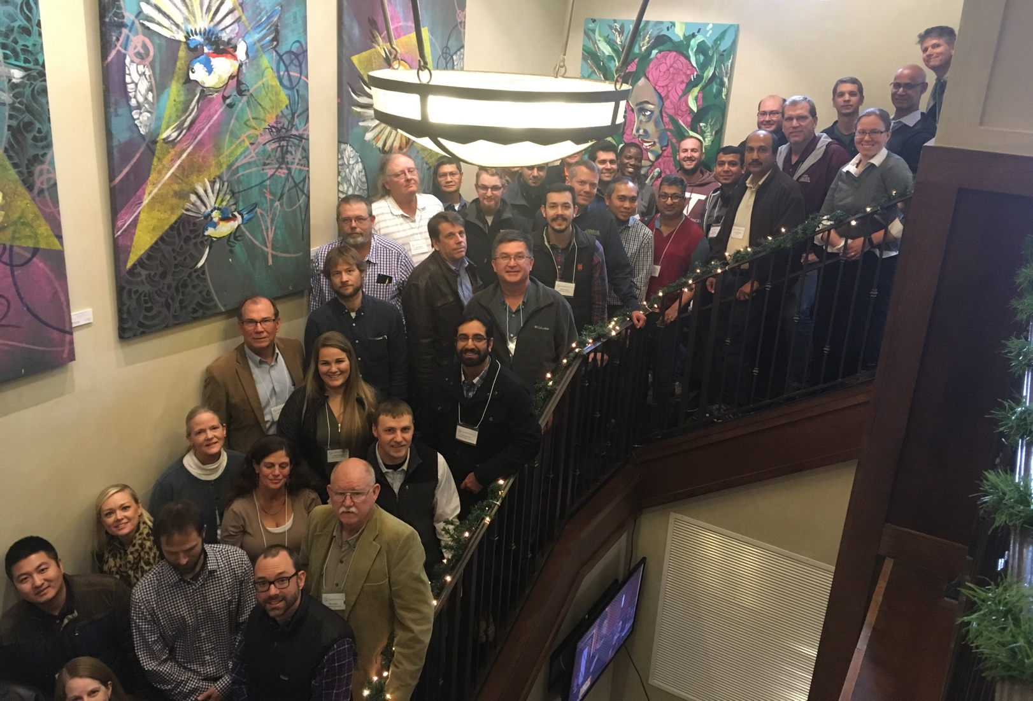
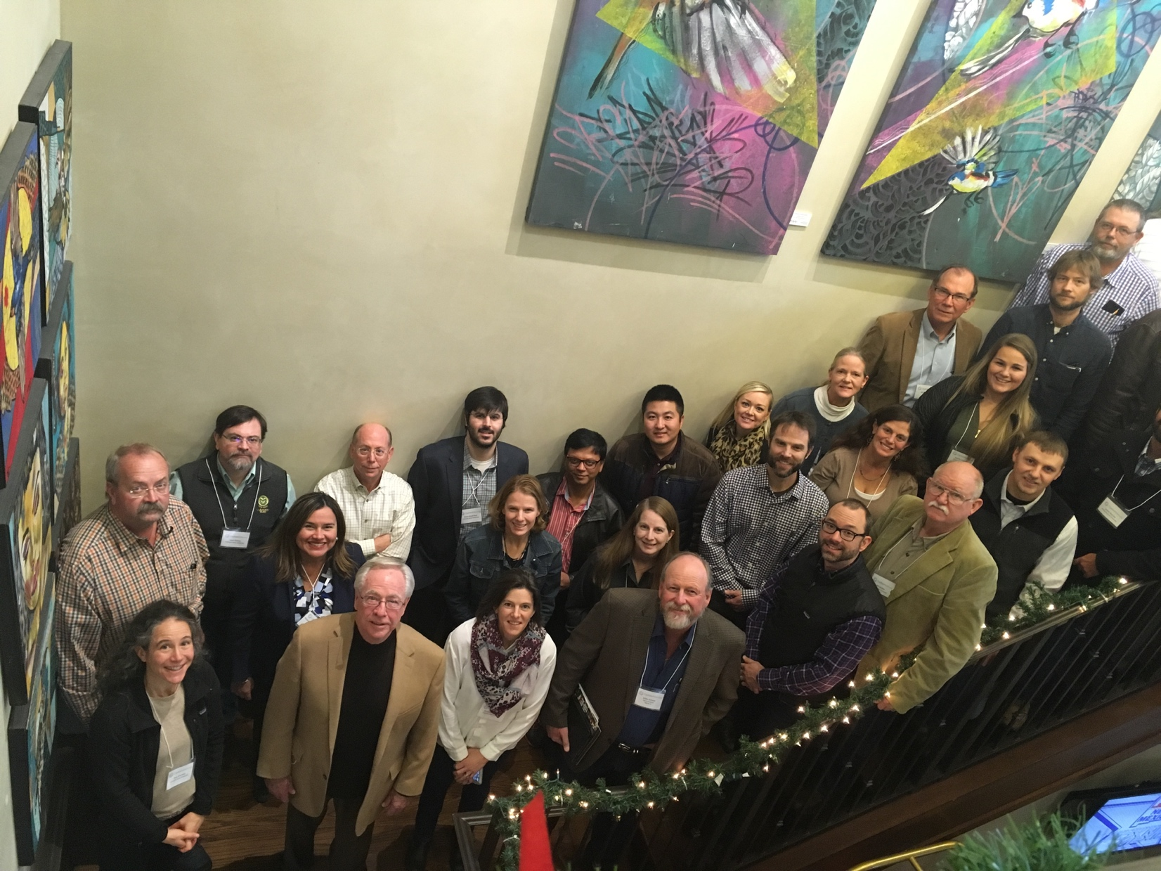

Ogallala Water Coordinated Ag Project
2016-2020 USDA-NIFA funded
> 70 people
9 institutions, 6 states
Informed by an Advisory Board
Notes:
It is at this intersection between existing groundwater and climates that we are working with the question of what next?

Slide 5
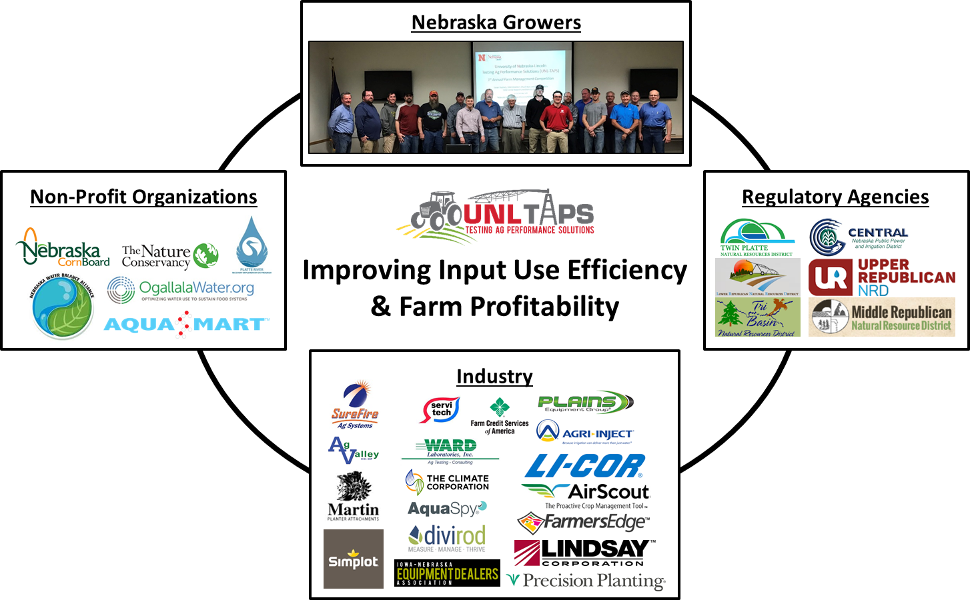


Integrated research and outreach
Source: D. Rudnick (UNL)
Notes:
Next steps:
The capstone session at the summit focused on identifying and prioritizing practical things we could work together on on a cross-state basis that could have a meaningful impact for the region. Next steps will involve working on expanding successful education/outreach activities already existing in one or more more states to other Ogallala states, for example (clockwise from top):
1. Master Irrigator program: The Master Irrigator Program is an irrigation management curriculum made up of 32 hours of intensive irrigation education conducted over four one-day sessions to show producers how to maximize advanced conservation irrigation management and conservation practices that work together to save water, conserve energy, build soil health and enhance farm profitability. Perfect attendance is required for EQIP funding and graduation of the course. Farmers not eligible for EQIP are still eligible to take the course- some have taken it more than once or sent staff from their operations seeing it as an investment that will save them money/water based on strategies they learn to improve their management/opportunity to learn from expert presenters including other producers.
There was great interest indicated among Summit participants in having a MI program like this in their states- a working group is forming with reps from state govts, universities, tech companies, etc. to work on this: creating a baseline curriculum, minimum set of standards to guarantee quality levels in a set of modules adaptable at a regional level. The multi-state approach will also be used to try to leverage funds to support cost-share dollars to support producers who complete these programs
2. Summit participants noted repeatedly that it’s hard for producers to adopt tech if they can’t make sense of what can do for them. Several excellent multi-state collaboration (and related outreach) programs are currently going on in different states, for example TAWC with Texas Tech University, the producer-led/university supported Water Tech Farms in KS, days and theTAPS program run out of the University of Nebraska-Lincolon Research and Extension Center in North Platte. UNL-TAPS hosts Farm Management Competitions that evaluate production and economic decisions made by competing "farms". In 2017, 15 “farms” competed held under a variable rate sprinkler irrigation system. In 2018, two competitions (corn and sorghum) are being held, both under under VRI. The competitions allow producers to make a series of management decisions that are implemented on the irrigation systems. For example, contestants in 2017 made decisions on crop insurance selection, planting density and hybrid selection, marketing strategy, irrigation scheduling and quantity, and fertilizer timing, amount, and method. The contestants submit their decisions as well as obtain information relevant to their plots through a password protected login on an online portal. A "demonstration-farm" has been created to show how the forms work and what information is provided to the participants.
Shown here are last year’s results- the TAPS program generates a ton of interest and data, and great interactions that tease apart which aspects of management lead to overall system profitability and efficiency– note howthe most profitable farm and least profitable farm in 2017 used about the same amount of water (9 inches)-there’s so much we are still figuring out with regard to improving management, water application amounts and timing, etc. This year farmers from NE and KS are participating in TAPS. Efforts are underway to get similar programs based on the TAPS model up and running in KS and OK.
Youth advocacy (TX 4H2O Ambassadors, KS Youth Water Advocates FFA)- another Summit working group is forming to find ways to make the Ogallala and production pathways from it/education related to conservation/systems management related to water and related career paths something they can be exposed to through FFA and/or F-H programs. Shifts are needed and shifting from status quo is hard- important to train/engage the youth, for whom keeping communities vital for the long term may be very relevant.

Slide 6
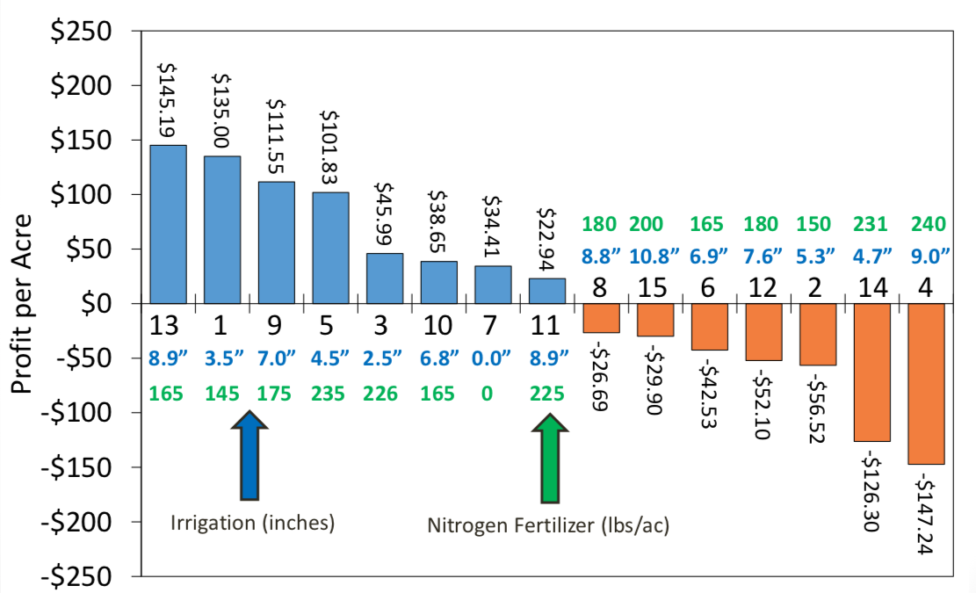
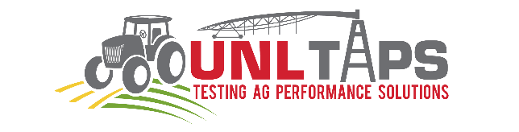
Balanced approach was the most profitable
1st prize:
Most profitable farm
2nd prize
Most water & N use efficient
3rd prize
Greatest yield
(x how profitable)
Yield
NUE & WUE
“I’ve really learned a lot by participating in the UNL-TAPS competition. There were a lot of really cool tools at our disposal and we have had the opportunity to see if they can add value to our operation without risk.”
-Producer Jon Walz
https://taps.unl.edu/
Notes:
CO producers can participate in this one; drip competition expansion

Slide 7
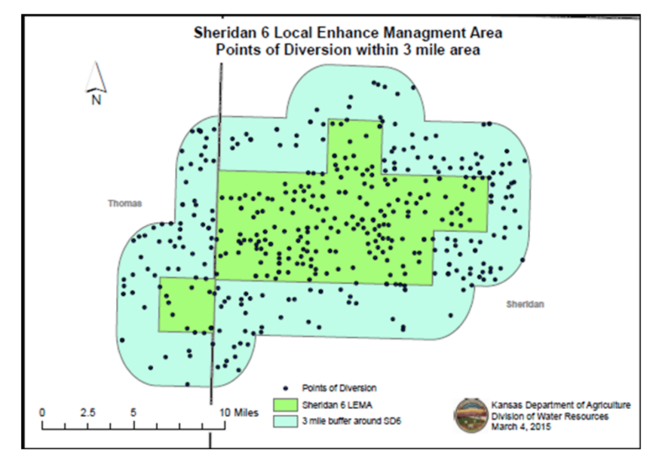
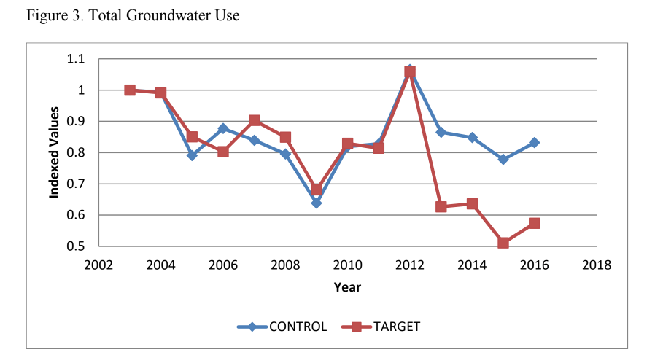
Lessons learned from voluntary efforts
Sheridan 6-Local Enhanced Management Area (LEMA) study
LEMA begins
26% decrease in groundwater use in study area compared to target area
Water use decrease=shifts in irrigated acreage of corn, alfalfa, grain sorghum, soy, wheat, mixed crops and mgmt
No net negative impact on cash flow
Liebsch & Golden, 2017

Slide 8
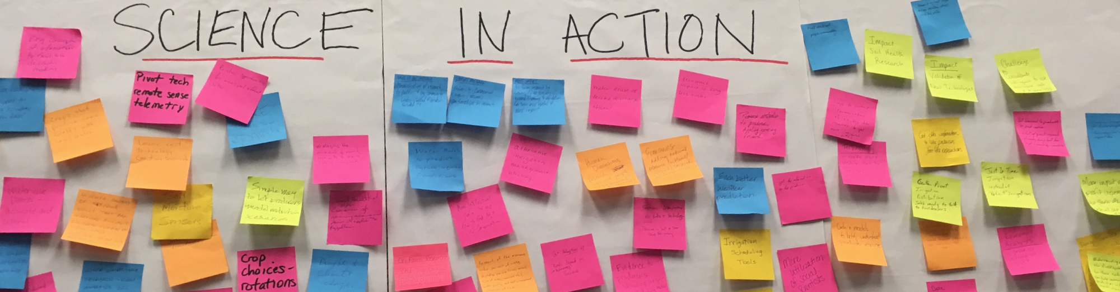
Take home points from 2018 Ogallala Summit
Having data on water use and water levels is essential
There are many things we can do now
Prioritize maximizing return on investment over maximizing yields
Peer-to-peer exchange among producers + industry engagement
Dynamic scheduling of irrigation can save time, water, money
Adaptation/improved water management depends on
  The policy + practice sandwich (tech alone will not “save us”)
“How do you make someone change [their water use practices]?
Set a groundwater production limit and hold their feet to the fire.
And show them that it pencils out.” -Summit participant
Notes:
Peer-to-peer exchange works supported by research/industry= fastest path to increase adoption
Having data on water use and water levels is essential both at the farm level and at the state/regional level to assess and better manage (you can’t manage what you don’t know)
There are many things we (producers, policy makers, researchers, communication specialists) can do now to shift towards systems optimization: once you wrap your head around one piece of real-time data- maybe it’s an irrigation scheduling program, soil sensors- VRI– there’s a wide range of price points- it becomes motivating to manage ever better– each turn of the pivot you don’t make can save money and water. More communication/visibility on this is needed- a lot of Ogallala coverage centers on “the sky is falling” which leads to a mentality that the declines are horrible but there’s not much we can do about it.
One of the most effective ways of getting people to consider management shifts related to water use is by hearing directly from other producers about the strategies they’ve tried (and their successes as well as their failures).

Slide 9
Part 2. Why conserve? What is the value of groundwater today and tomorrow?

Slide 10
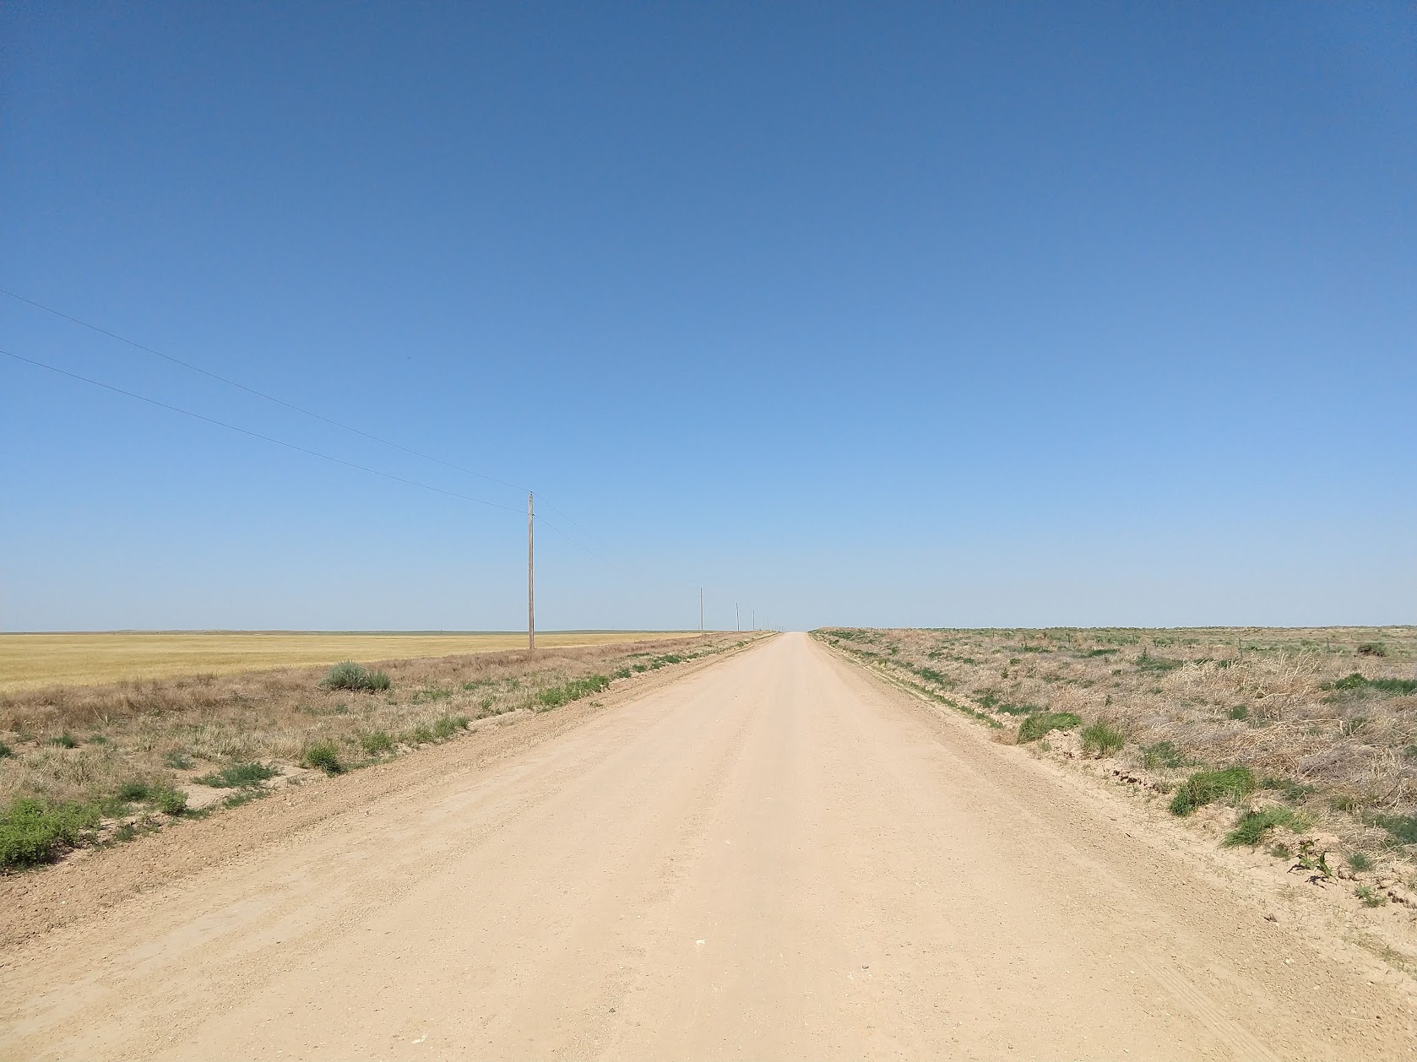
What is the value of the water?
“Why we need to have many conversations about conservation…
…and why the conversations should focus on
what we are conserving
and not just how to conserve
[although that is important]”
Matthew R. Sanderson, Ph.D. Randall C. Hill Distinguished Professor of Sociology Kansas State University | Stephen Lauer Doctoral student, Sociology Kansas State University

Slide 11
Data and Methods
Goal: representative sample of producers
227 counties in 6 states
January – July, 2018
7,712 eligible
1,226 responses = 15.9% response rate
Qi, 2010

Slide 12
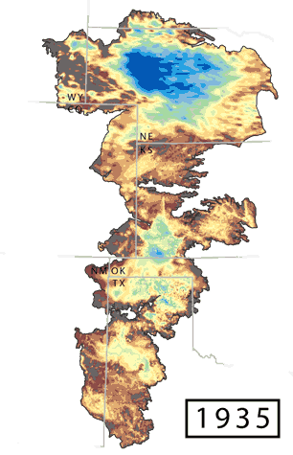
“How serious of a problem
is groundwater decline?”
NE 39.0 % / 42.1%
KS 14.5 % / 74.4%
CO 23.1% / 66.47%
Generally not serious
Generally serious
OK
14.3 %
79.6%
NM 8.8% / 85.3%
TX
11.8 %
83.5%
Haacker et al. 2015

Slide 13
Should groundwater be saved or conserved?
Yes or No
  94 no-response [7.7%]
Overall ~ 9/10 say “yes”
  85% with non-responses
By state, no fewer than 8/10 say “yes” [with non-responses]
CO = 81%
NE = 83%
TX = 84%
KS = 90%
OK = 92%
NM = 94%
As a robustness check…
n = 86
YES
n = 1,046

Slide 14
“Groundwater should be used.
Groundwater does no good in the ground.”
Overall, 24% agree
By state, no more than 1/3 agree or strongly agree:
  CO = 33%
  TX = 29%
  NE = 27%
  NM = 24%
  OK = 19%
  KS = 14%

Slide 15
“How certain are you that you could reduce groundwater use beyond what you are using now?”
NE 65.5 % / 15.5%
Probably cannot do
Probably can do
KS 70.0% / 18.4%
CO 72.8 % / 14.6%
OK
73.2%
14.6%
NM 79.3 / 6.9%
TX
78.1%
8.8%

Slide 16
Barriers to conservation? % Agree/Strongly Agree
“Most people do not save more groundwater because…”
water use regulations are not strict enough. 46%
if they do not pump the water, someone else will. 49%
they are self-interested/greedy. 53%
it would require more expensive technology. 54%
they do not want to change their irrigation practices. 65%
it would decrease their production. 76%
More common
Very common
If it should be conserved, why? For whom/what should we save it?

Slide 17
Groundwater should be conserved today so that…
“…it is available to producers if drought becomes more frequent in the future.”
"…jobs and business opportunities continue to be available in my community in the future.”
“…my children and grandchildren can enjoy the benefits I have experienced.”
73% Agree
66% Agree
”.…future generations in my area can enjoy the benefits I have experienced.”
85-86% Agree
Voluntary participation?...
Notes:
… Define and talk more openly about the social and cultural values of water. Preliminary results from more than 1200 survey respondents from across the region reinforce this concept that stakeholders see a value in the water tomorrow as well as the short-term economic value today. The greatest agreement regarding the reasons to conserve were for reducing drought risk and more altruistic reasons of supporting community and family into the future. Harnessing these values on the future can help build that adaptive capacity through new networks and community-driven support of conservation.

Slide 18
“Most people do not save more groundwater because water use regulations are not strict enough.”
NE 31.0 % / 33.5%
KS 18.5% / 42.0%
Generally disagree
Generally agree
CO 29.0% / 38.3%
OK
10.9%
41.3%
NM 26.7% / 36.7%
TX
16.0%
37.8%

Slide 19
So, there is concern and interest in sustaining groundwater for the future… how do we get there faster?
Part 3. Evaluating policies and practice options

Slide 20
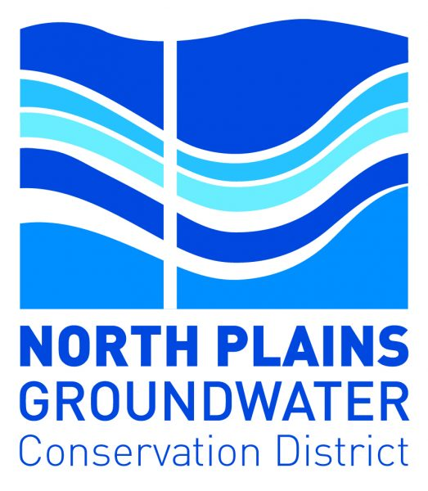
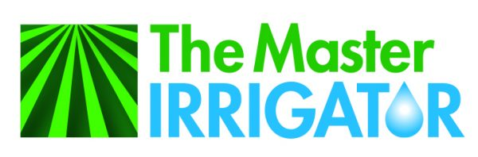
Linking water management training to practice adoption incentives
4-day intensive education program on crop/irrigation management
Locally adapted curriculum & NRCS EQIP cost-share “carrot”
9/20/18: Multi-state meeting: 7 states (CO, KS, NE, NM, MN, OK, TX)
Outcome: each state (or districts) interested in pursuing the development of a program in their state (or within districts)
Groups in multiple states are developing plans/proposal(s) to support these programs
Notes:
Next steps:
The capstone session at the summit focused on identifying and prioritizing practical things we could work together on on a cross-state basis that could have a meaningful impact for the region. Next steps will involve working on expanding successful education/outreach activities already existing in one or more more states to other Ogallala states, for example (clockwise from top):
1. Master Irrigator program: The Master Irrigator Program is an irrigation management curriculum made up of 32 hours of intensive irrigation education conducted over four one-day sessions to show producers how to maximize advanced conservation irrigation management and conservation practices that work together to save water, conserve energy, build soil health and enhance farm profitability. Perfect attendance is required for EQIP funding and graduation of the course. Farmers not eligible for EQIP are still eligible to take the course- some have taken it more than once or sent staff from their operations seeing it as an investment that will save them money/water based on strategies they learn to improve their management/opportunity to learn from expert presenters including other producers.
There was great interest indicated among Summit participants in having a MI program like this in their states- a working group is forming with reps from state govts, universities, tech companies, etc. to work on this: creating a baseline curriculum, minimum set of standards to guarantee quality levels in a set of modules adaptable at a regional level. The multi-state approach will also be used to try to leverage funds to support cost-share dollars to support producers who complete these programs
2. Summit participants noted repeatedly that it’s hard for producers to adopt tech if they can’t make sense of what can do for them. Several excellent multi-state collaboration (and related outreach) programs are currently going on in different states, for example TAWC with Texas Tech University, the producer-led/university supported Water Tech Farms in KS, days and theTAPS program run out of the University of Nebraska-Lincolon Research and Extension Center in North Platte. UNL-TAPS hosts Farm Management Competitions that evaluate production and economic decisions made by competing "farms". In 2017, 15 “farms” competed held under a variable rate sprinkler irrigation system. In 2018, two competitions (corn and sorghum) are being held, both under under VRI. The competitions allow producers to make a series of management decisions that are implemented on the irrigation systems. For example, contestants in 2017 made decisions on crop insurance selection, planting density and hybrid selection, marketing strategy, irrigation scheduling and quantity, and fertilizer timing, amount, and method. The contestants submit their decisions as well as obtain information relevant to their plots through a password protected login on an online portal. A "demonstration-farm" has been created to show how the forms work and what information is provided to the participants.
Shown here are last year’s results- the TAPS program generates a ton of interest and data, and great interactions that tease apart which aspects of management lead to overall system profitability and efficiency– note howthe most profitable farm and least profitable farm in 2017 used about the same amount of water (9 inches)-there’s so much we are still figuring out with regard to improving management, water application amounts and timing, etc. This year farmers from NE and KS are participating in TAPS. Efforts are underway to get similar programs based on the TAPS model up and running in KS and OK.
Youth advocacy (TX 4H2O Ambassadors, KS Youth Water Advocates FFA)- another Summit working group is forming to find ways to make the Ogallala and production pathways from it/education related to conservation/systems management related to water and related career paths something they can be exposed to through FFA and/or F-H programs. Shifts are needed and shifting from status quo is hard- important to train/engage the youth, for whom keeping communities vital for the long term may be very relevant.

Slide 21
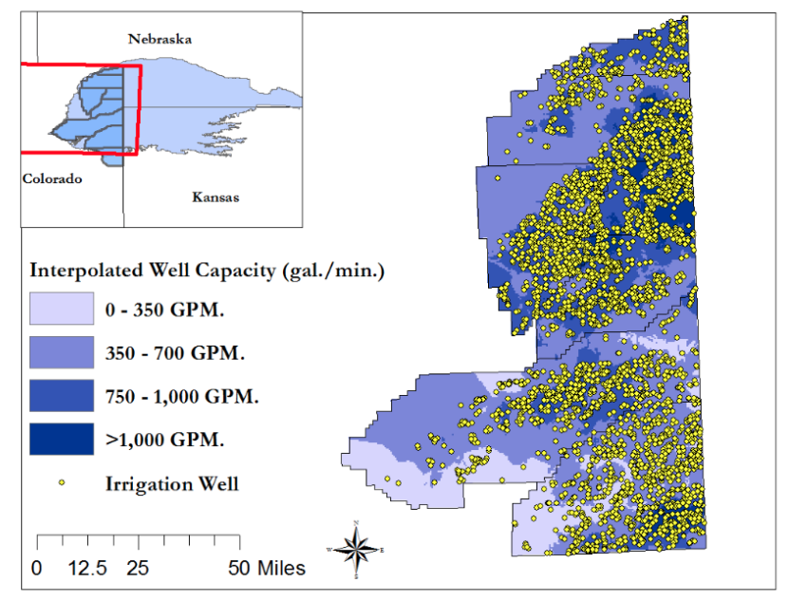
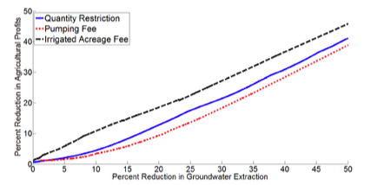
Previous work: Partnership between WPP and CSU for economic analysis of options in the Republican River Basin
Goal: Extending life of aquifer by reducing pumping by 25%
Take home: the lowest cost way to reduce groundwater use across the Basin in the short run is through a pumping fee rather than set quantity restriction or acreage fee.
Manning et al. 2016
Notes:
Assumptions were status quo management

Slide 22
Evaluating the relative impact of management and policy
Decision support systems to evaluate options
‘What if’ scenarios:
Crop choice
Improved crop genetics
Irrigation management
Water restrictions
Incentives
Climate
Historical & Future
Surface water model
Crop growth model
Economic models
Groundwater model
R. Bailey, P. Gowda, I. Kisekka, D. Manning, et al.

Slide 24
Questions
1. What are the options we should evaluate?
Practices?
Policies?
2. Who should we be talking to? What should we be sharing? How can we be most helpful?
Colorado Groundwater Commission
Others?

Slide 25
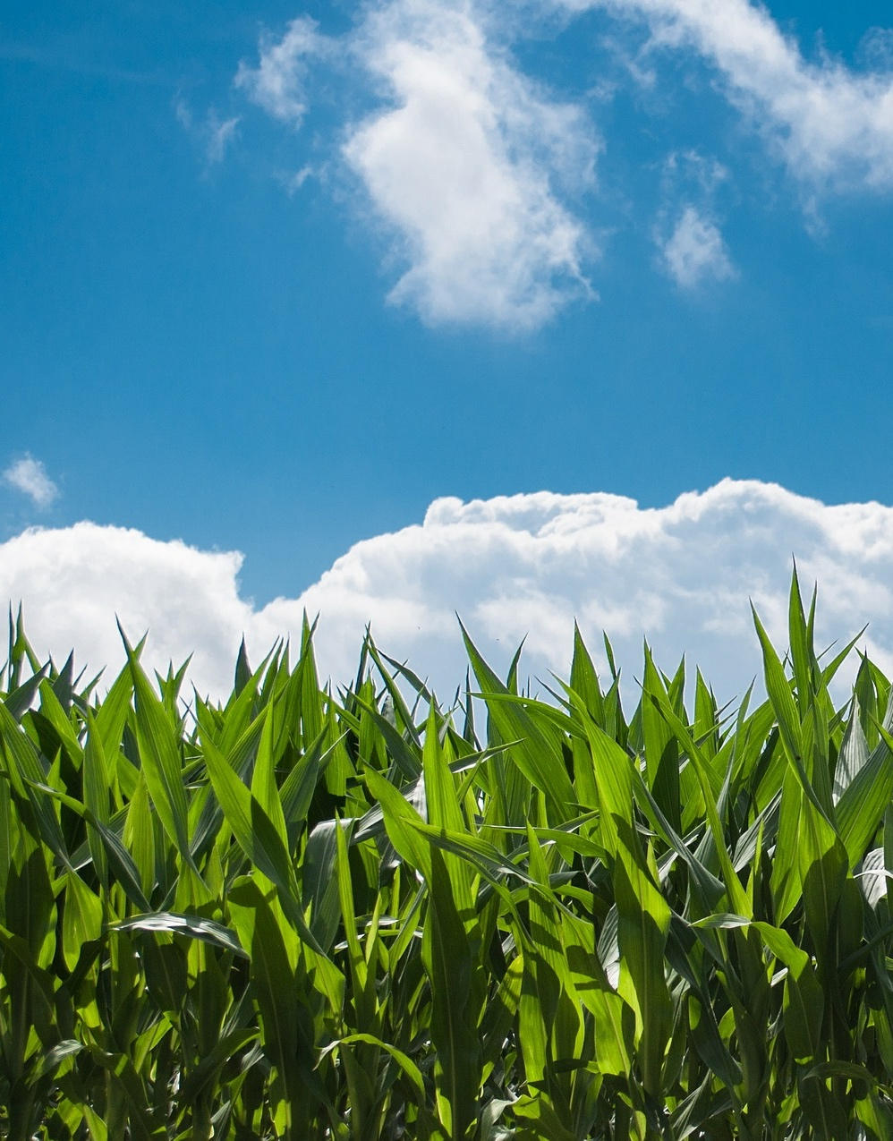
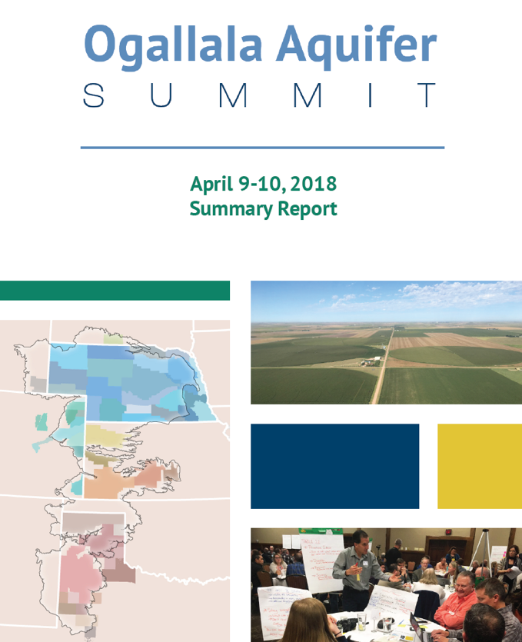
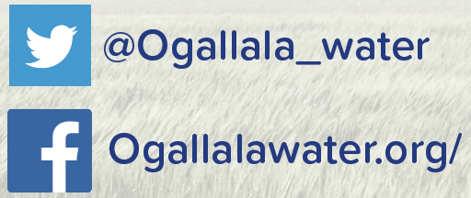
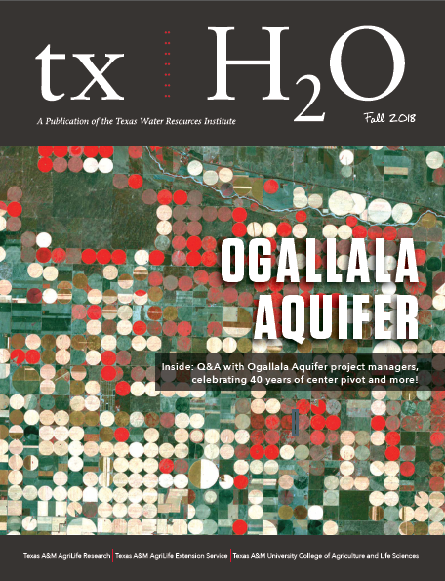

Questions?
Meagan.Schipanski@colostate.edu
Amy.Kremen@colostate.edu
Quarterly newsletter sign-up:
Ogallalawater.org
Support comes from the National Institute of Food and Agriculture, U.S. Department of Agriculture, award number 2016-68007-25066.

Slide 26
Questions
1. What are the options we should evaluate?
Practices?
Policies?
2. Who should we be talking to? What should we be sharing? How can we be most helpful?
Colorado Groundwater Commission
Others?

